Slide 1
Webinar 3: Increased sexual and gender-based violence, domestic violence and violence against children during crises (including COVID-19) and how to prevent and respond to it
Webinar Training
^{19th} November 2020

Slide 2
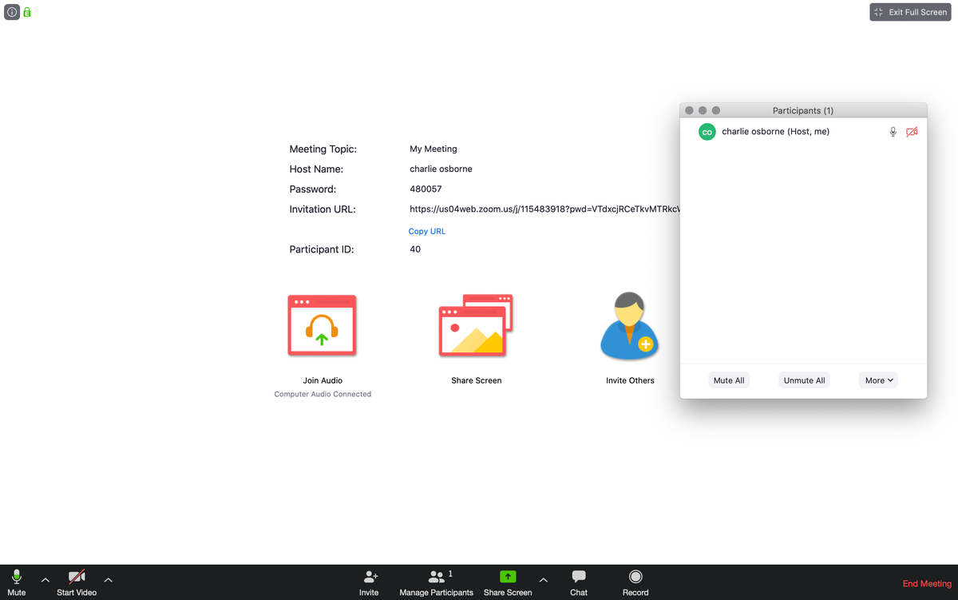
Before we start
Please keep your cameras off during the presentation section
The host will unmute your microphones before you go into breakout rooms so you can speak to each other in the breakout room
During the breakout and afterwards feel free to keep your camera on
We will leave time after the webinar for a ‘virtual tea break’

Slide 3
Learning Objectives
To identify the potential risks of different forms of violence against women and children, including and sexual and gender-based violence, in the context of COVID-19
To understand and review locally appropriate prevention and response actions

Slide 4
Target audience
The Social service workforce (SSW)
Justice, Law and Order Sector (JLOS)
Civil Society Organizations (CSO)
Notes:
The SSW include probation and social welfare officers, community development officers, assistant community development officers and case managers and social workers).
The JLOS include: magistrates, legal aid officers and police)
The CSOs include: GBV workers, child protection and social protection practitioners
All these actors play a critical role in the prevention and response to all forms of violence against women and children.

Slide 5
A reminder: Structure of the webinars
Welcome (5 minutes)
Core technical topic (35 minutes)
Breakout rooms (10 minutes)
Reflection (10 minutes)
Post-webinar survey (2 minutes)
Notes:
The emphasis will be on practical information relating to compliance with national guidelines and will seek to provide a strengths-based approach, highlighting successes from Uganda and elsewhere.
Focusing on challenges/uncertainties that participants face, examples of how participants are addressing the problem and creation of an action plan by each county and sub-county Children’s Officer (15 minutes).
This can also be a time to discuss an existing case, or have some self-care activities, if needed and/or requested by the participants.

Slide 6
Webinar 3: Welcome and introduction
Overall aim of this webinar: To identify the potential risks contributing to violence against women and children, including sexual and gender-based violence, in the context of COVID-19, and to explore locally appropriate prevention and response actions
Key principles informing the session
Strengths-based
Useful for here and now but also forward looking
Informed by global guidance and child rights instruments
Contextualized and fit for purpose (i.e., practical)
Participatory

Slide 7
Breakout time!
Please write down this question:
What can we do to prevent and respond to violence during COVID-19?
You will be discussing this later in your breakout groups

Slide 8
Before we begin – key messages
Violence is never okay!
GoU is committed to prevent violence against children (VAC) and women and sexual gender-based violence (SGBV).
Core function of the social service workforce (SSW): identify, prevent and support anyone at risk of or experiencing violence.
The workforce should use the power they hold positively to ensure safety of the survivor, refer & link survivors to services, respect privacy of the survivor and involve them in the helping process, document cases, and prioritize welfare needs of the survivor.
Notes:
The social service workforce (SSW) is a broad range of governmental and nongovernmental professionals and paraprofessionals who work with children, youth, adults, older persons, families and communities to ensure healthy development and well-being. It comprises a broad range of actors including but not limited to social workers, social educators, childcare workers, youth workers, child and youth care workers, community development workers/community liaison officers, community workers, welfare officers, social/cultural animators and case managers. http://www.socialserviceworkforce.org/workforce

Slide 9
Violence definitions
Violence
All forms of physical or mental injury or abuse, neglect or negligent treatment, maltreatment and exploitation, including sexual abuse, intentional use of physical force or power, threatened or actual
Sexual and gender-based violence
Any sexual act that is perpetrated against a person’s will and is based on gender norms and unequal power relationships
Intimate partner violence
Physical violence, sexual violence, stalking, or psychological harm by a current or former partner or spouse. It is the most common form of violence against women.
Notes:
Source of definitions
Violence against children: Children Act (as amended) 2016, CAP 59. Act 9
Sexual Violence: National Violence Against Children Survey; Findings from the Survey, MGLSD 2018.
Intimate Partner Violence: Center for Disease Control and Prevention. https://www.cdc.gov/violenceprevention/intimatepartnerviolence/index.html
Webinar guidance:
Explain that these are all Ugandan government definitions. If wished, can read out the sexual violence definition below.
Ask people if they have any questions about the definitions.
Optional, ask people if they think that all forms of gender-based violence are sexual violence?
Includes child marriage; female genital mutilation; forced marriage; forced wife inheritance; sexual violence within marriage; virginity testing; widow cleansing; damage to property; defilement; harassment; incest; intimidation; physical abuse; sexual abuse; stalking; verbal abuse
Perpetrated against men and women – in practice, most GBV perpetrated against women
Sexual violence is defined as including all forms of sexual abuse and sexual exploitation of children. This encompasses a range of acts, including completed non-consensual sex acts, attempted non-consensual sex acts, and abusive sexual contact. This also includes the exploitative use of children for sex. From - National Violence Against Children Survey; Findings from the Survey, MGLSD 2018.
Gender-based violence is violence directed against a person because of that person's gender or violence that affects persons of a particular gender disproportionately.

Slide 10
Relationship between power, gender and violence
GBV is a result of an unequal balance of power between women and men, boys, and girls.
It cuts across cultures, ethnic groups, socioeconomic statuses, and religions.
Power can be negative or positive depending on how the person who wields it uses it.
Negative power is the power we exert over others, it is at the root of violence against women and children. Positive power holds the solution to turn the balance.
The workforce can transform negative uses of power into positive use to facilitate prevention and effective response to VAC/W by identifying and implementing solutions to prevent violence.
Notes:
*Adapted from the Coordinating Comprehensive Care for Children (4Children) CPD on SGBV/VAC, 2020.
*Other info sources - Allen, Amy, 2016. "Feminist Perspectives on Power", The Stanford Encyclopedia of Philosophy
The SSW can positively use power by referring and linking survivors to appropriate services; respecting privacy of the survivor; involving the survivor in the helping process; documenting the case management process; prioritizing welfare needs of the survivor.

Slide 11
VAC/W and GBV in the context of COVID-19
The current pandemic has amplified cases of domestic violence against women and children globally and nationally:
Increased concerns and reports on GBV have been expressed in many countries like China, France, Spain, Italy and the UK.
Domestic abuse killings more than doubled in first month of containment measures in the United Kingdom.
Similarly, in Uganda there has been a reported increase on GBV – 3,280 cases reported to the police between March and April with an additional 283 VAC cases.
*When you have the time, watch this 1.30-hour video discussion on increase of VAC/GBV from a few experts around the world https://www.youtube.com/watch?v=X1_zU98xZso&feature=youtu.be
Notes:
Taub A. A New Covid-19 Crisis: Domestic Abuse Rises Worldwide. New York Times. April 6, 2020 https://www.nytimes.com/2020/04/06/world/coronavirus-domestic-violence.html
UCHL recorded 1902 reported cases violence - sexual violence (1152) and physical violence (750) against children from beginning of year
1.8 billion children live in 104 countries where violence response and prevention services have been disrupted due to COVID 19
Suicide cases registered by the Ugandan police. Suicide rates have increased by 20% in comparison to last year with 257 suicide cases (population between 17 – 48 years) recorded by August 2020.
https://capitalradio.co.ug/police-registers-increase-suicide-cases/
4. Ask people to note in the chat box if they have noticed any increased calls themselves. Ask them to note What types of violence they are noticing and how these are being reported

Slide 12
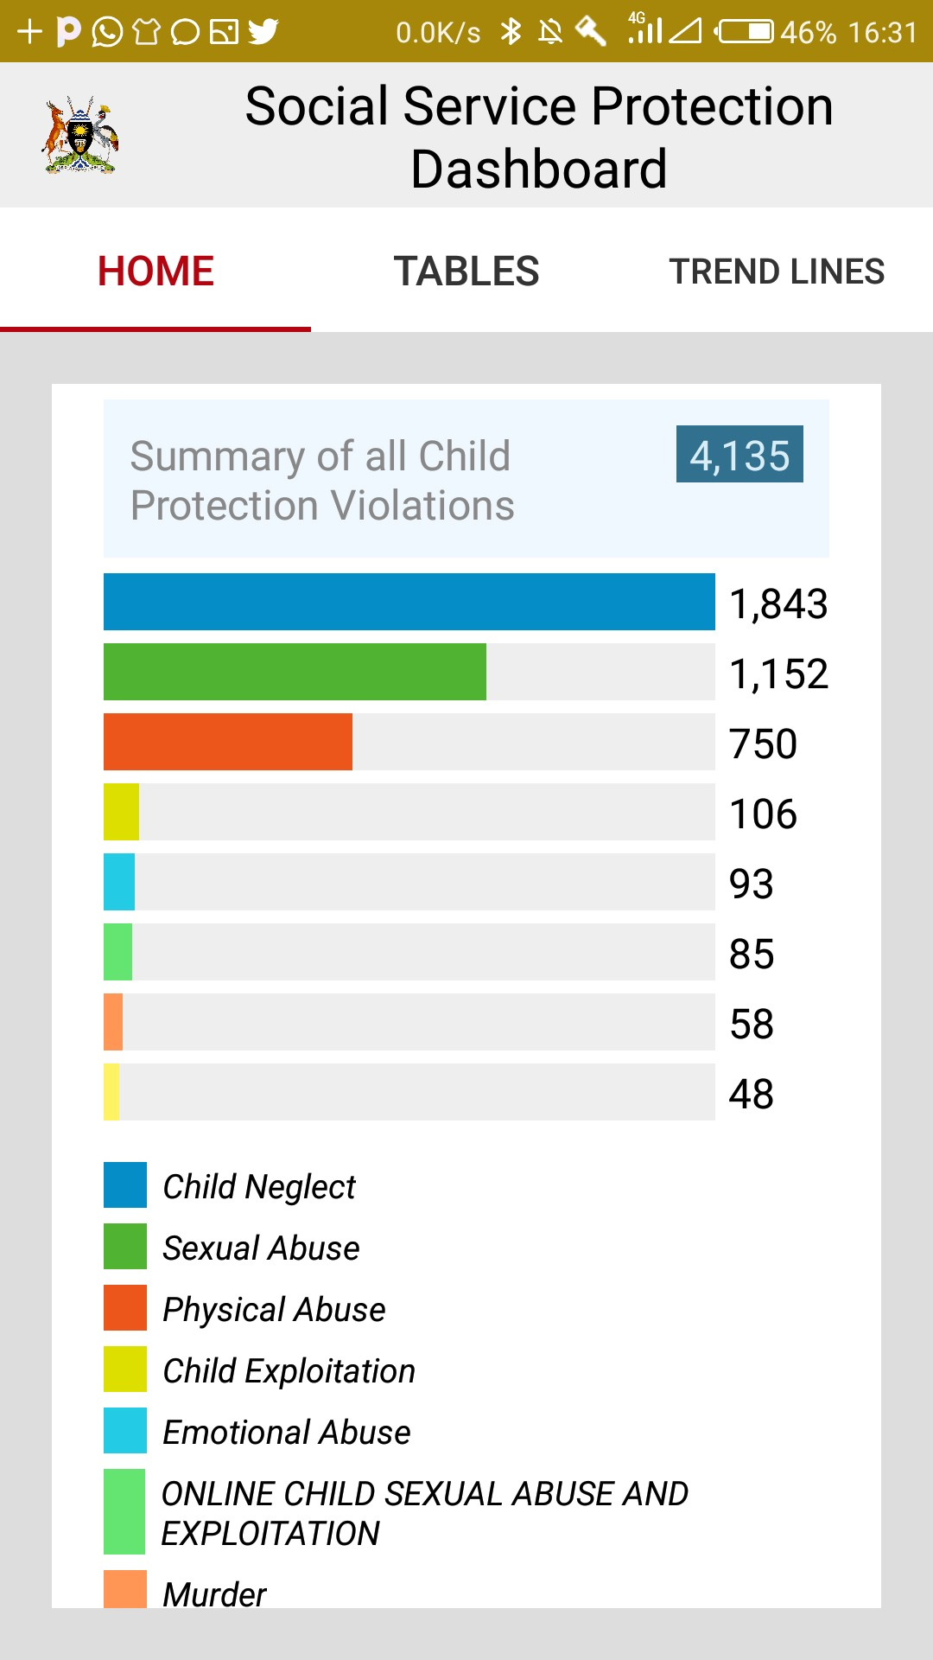
VAC/W and GBV in the context of COVID-19
Calls to the UCHL significantly increased since the implementation of the containment measures, peaking in May with 41,997 calls, an average of 1354 daily calls.
Reports on VAC progressively increased since school closure with August seeing a 44% increase in reported VAC cases at UCHL call centre.
Notes:
Source: Uganda Child Helpline monthly reports (Jan – Aug 2020) and the Social Service Protection Dashboard – SSW App

Slide 13
Why are levels of violence increasing during COVID-19 ?
1. Economic insecurity and poverty-related stress
Pathways can be both direct & indirect, and are likely to interact, reinforcing existing vulnerabilities.
These pathways will depend on the type of vulnerability and contextual factors, including underlying gender norms and levels of GBV, VAW and VAC
9. Violence perpetrated against health workers & CP staff
2. Quarantines & social isolation
Pathways linking pandemics & GBV and VAC
8. Exposure to violence & coercion in response efforts
3. Disaster & conflict-related unrest & instability
7. Inability of women to temporarily escape abusive partners
4. Exposure to exploitative relationships due to changing demographics
6. Virus-specific sources of violence
5. Reduced health services availability and access to first responders
Notes:
Economic insecurity and poverty-related stress: Poverty-related stress and economic insecurity correlate with poor coping strategies (e.g., substance abuse) can lead to increases in intimate partner violence and child maltreatment. When unemployment rates skyrocket and economies slow to a halt, VAW/C is likely to increase as a result of related stress.
Quarantines and social isolation: Close quarters, especially those tied to stressful conditions, are linked to stress, fear, poor mental health, and disorders, which can in turn increase the likelihood of VAW/C. Evidence focused on other crisis settings, including refugee camps and humanitarian assistance zones, confirms that when family members are in close proximity under conditions of duress for extended periods of time, rates of VAW/C are high. Quarantine also increases face-to-face exposure to perpetrators and can reinforce abuse tactics of social isolation.
Disaster- and conflict-related unrest and instability: Pandemics can break down social infrastructure, compounding existing weaknesses in conflict and disaster settings. This may lead to increased family separation, intra-familial violence, and exposure of women and children to unsafe conditions, including exposure to sexual violence and harassment as they seek to obtain basic goods, including food, firewood, and water.
Exposure to exploitative relationships due to changing demographics: Higher mortality rates drive extended family networks to care for orphans who have lost their parents to disease, creating new strains on households and risking a decreased quality of care, and even violence, directed at children. Changing family structures, combined with school closures and financial duress, can result in higher rates of exploitative, transactional sex among adolescent girls and higher fertility rates, with longer-term consequences for increased VAW/C.
Reduced health service availability and access to first responders: Health providers and emergency first responders are often the first point of contact for survivors, as well as sources of short-term physical protection for women and children. With all hands on deck needed to respond to pandemics, first responder resources and referral pathways that survivors rely on may not be available unless, following France’s example, intentional efforts are made to provide accessible points of assistance. In addition, women may avoid seeking health services for physical abuse and injuries, for fear of possible infection.
Virus-specific sources of violence: The COVID-19 pandemic has already documented ways perpetrators are using virus-specific misinformation and scare-tactics, as well as controlling behaviors to withhold safety items. In other pandemics, including the HIV/AIDS, violence has been linked to disclosure of serostatus, or may increase risk of lifelong exposure to violence due to coinciding disabilities (e.g. microcephaly within the Zika outbreak).
Inability of women to temporarily escape abusive partners: Women already face complex decisions and a wide range of barriers preventing their ability to safely escape abusive partners. In times of pandemic, when mobility is constrained, social distancing measures are imposed, economic vulnerability increases, and legal (social services) are scaled back, challenges in temporarily escaping abusive partners are exacerbated.
Exposure to violence and coercion in response efforts: There have been documented cases of aid workers responsible for assisting vulnerable populations in times of crisis committing acts of violence against women and children. Unequal power dynamics open up possibilities for those meant to help—including, as seen in the Ebola response, health workers, taxi drivers, and even burial teams—to pressure populations into exploitative relationships in exchange for transport, food, cash, and vaccines.
Violence against health care workers: Women make up nearly 70 percent of the global health workforce and are regularly subjected to abuse and harassment from colleagues and patients. Risks may be heightened in pandemic settings, harming women themselves and the crippling the effectiveness of broader health systems.

Slide 14
Chat box
What types of violence are you noticing in your local community and in your work?
Who is the violence perpetrated against?
Who is the violence perpetrated by?
Is it reported?
How is it being responded to?

Slide 15
Legal and policy framework
The Domestic Violence Act 2010 and its Regulations 2011
The prohibition of Female Genital Mutilation 2010 and Its regulations 2013
The Prevention of Trafficking in Persons Act 2009
The Penal code Act, Cap 120
The Children Act (as amended, 2016) Cap 59
The International Criminal Court Act 2010; The Magistrates Courts Act, Cap 16
The Evidence Act, Cap 6
The Trial on Indictments Act, Cap 23.
Other laws include the land Act, cap 227, the Employment (sexual Harassment regulations 2012
The Government has also developed policies and frameworks to prevent and respond to VAC & GBV these include; The National Child Policy, 2020 and its Implementation Plan, 2020/21-2024/25; The Uganda Gender Policy(2007); The National Action Plan on Women(2008); The National Development Plan(NDP) 2010/11 - 2014/15 ; National Referral Pathway for Prevention and Response to Gender Based Violence Cases in Uganda (2013); National Guidelines on establishment and Management of GBV Shelters in Uganda and The National Action Plan on the United Nations Security Council Resolution 1325, 1820 and Goma Declaration(2008);
Notes:
Note: Please emphasize that all these legal instruments and policy frameworks are applicable in all types of emergencies.
An annex with the legal instruments and policy frameworks and their specific provisions to VAC/GBV is annexed to handouts and will be provided to all participants.

Slide 16
Key Messages to the workforce
Social service workers can be advocates to the government and for victims and can take a leading role in obtaining justice by working closely with the justice, law and order sector.
The SSW can ensure comprehensive prevention and service responses to VAC/VAW by mobilizing partnerships and referral networks of service providers in the community to ensure that victims/survivors receive all the appropriate services they require.
The SSW and CSOs can play a key role in supporting communities in changing norms and societal behaviours and preventing violence. The prevention of violence against women and children depends on changing community norms about gender concerns (e.g. equality, equity, power relations, biases, stereotypes) and the acceptability of violence against women.
The SSW and CSOs can influence change through community mobilization programmes to change violence-related attitudes and behaviours and promote more equitable relationships between men and women. Prevention of VAC/Women also requires that society holds perpetrators accountable without blaming victims/survivors.

Slide 17
Key Messages
CSOs should coordinate with the SSW and local leaders and work within existing government structures to ease follow up, referrals and management of VAC/women.
The JLOS (police, magistrates, legal aid officers, etc) should apply a victim-centred approach that is sensitive to the factors that impact victims of violence and treats victims with respect and dignity. This can help to reduce attrition rates, re-traumatisation of victims and access to justice.
Victims have often experienced trauma as a result of the violence perpetrated against them. Trauma affects the brain, memory and behaviour of victims in a way that can induce shame in the victim and also make reporting and testifying to their experience difficult. An understanding of how trauma may be affecting victims and sensitivity to their situation is important in assisting both victims and the court process.
People who frequently hear distressing stories of violence (e.g. the judiciary, the police, health workers, child protection and GBV actors, etc,) also may experience trauma from hearing cases of violence and need to engage in self-care to stay health and continue to perform their role to the best of their ability.
Notes:
A victim centered approach can include keeping the victim informed about the progress of the case and what is expected of them, reducing unnecessary delays, protecting the victim’s privacy and adopting special procedures to ensure victims are safe from intimidation and further trauma when testifying in court.

Slide 18
Stay informed and prepared
Information
Services
Coordination
Keep yourself updated on the latest VAC/W and SGBV information
Act when you suspect or identify VAC/W
Keep updated on local service provision
Contacts with health and police
Are local GBV services operating and, if so, on a normal schedule?
Are there local NGOs conducting violence prevention work?
Coordinate with formal and community service providers and networks
Chiefs and religious institutions
Local FM stations and media
Police, health, education
Notes:
Take emergency action if needed; Offer immediate and ongoing support; follow the Standard Case Management Practice; Remember your own safety – protective clothing and access to soap and water.
Coordination w/ non-GBV and non-CP actors
Update service mapping and referral pathways and disseminate using age-, language-, and disability- appropriate modalities
Training on signs/symptoms, how to handle disclosures, safe referral
Joint activities to reach child/adolescent survivors
Coordination w/ grassroots or community-based child protection networks, youth groups/networks, women-led organizations/networks, and disability-focused organizations/networks

Slide 19
Preventing further violence
Remember – violence is NEVER OK
Include VAC and GBV messaging in COVID-19 awareness raising
Publicize helplines and hotlines
Remind people of Child Helpline 116; Email sautichl@gmail.com (8am – 5pm)
MoH: 0800-100-066 0800-203-033 0800-303-033
Free counselling dial *252# (select option 10)
Police Emergency hotline: 999/112
0782 909153; 0772 460297; 0772 469 323
Psychosocial support and parenting tips
Stress reduction tips
Positive parenting
Safety planning with vulnerable clients
Always check they can talk
Help prepare safety plan (details in job aid)
Schedule regular calls
Notes:
Supporting existing survivors
Put a poster outside the office or house
Announce on popular media outlets such as radios

Slide 20
Special considerations for IPV and VAC
Grave concerns on exponential increase in intimate partner violence during COVID-19
Integrate efforts to prevent and respond to all forms of violence against women, children and adolescents into COVID-19 response plans
Influence social norms and related behaviors to better safeguard children at home
Identify positive and negative coping mechanisms or behaviors that are strengthened and exacerbated by the pandemic (e.g. alcohol use).
Step up awareness campaigns, including targeting men at home.
Work with community and religious leaders to raise awareness and influence positive behavior through targeted messaging.
Advocate for the designation of domestic violence shelters as essential services and increase resources to them and to civil society groups on the front line of response.
Notes:
This slide sums up the considerations for IPV/VAC violence during COVID
Anecdotal reports on the TV and print media indicate an alarming increase (153%) in intimate partner violence since lockdown and containment measures in March 2020 – NTV show (CEDECOV, MGLSD & Frank Tumwebaze, MGLSD told reporters that there has been an increase in GBV as the country is under lockdown to prevent the spread of COVID-19. "Some of these cases have already claimed lives of Ugandans even before COVID-19 does so,’’ he said, noting that between March 30 and April 28, a total of 3,280 cases of GBV were reported to police (New Vision, April 28, 2020); COVID-19 Impact on GBV – NTV COVID-19 Forum. #NTVNews #NTVCOVID19Forum #EndGBV
70% of respondents cited IPV as the type of they were experiencing in their community (Concern for Girl Child Assessment report)

Slide 21
Case Management Considerations during COVID
While COVID-19 infection has lower mortality rate, it is highly contagious and demands higher level of flexibility, and a more layered approach to GBV case management service delivery than in past epidemics.
Case Management, by definition, functions as the central point that links children and families to multiple services
Case management remains a critical service that is possible to continue in most cases with sufficient modification and adaptations to uphold public health guidelines.
All duty bearers should:
Ensure that all service centers such as GBV shelters have Infection, Prevention and Control (IPC) measures in accordance with standards at all service delivery points.
Communicate openly with women and girls about COVID-19 and any changes or potential changes in your methods of service delivery.
Notes:
‘GBV AOR Help Desk: GBV Case Management and the COVID-19 Pandemic’
https://gbvguidelines.org/wp/wp-content/uploads/2020/03/guidance-on-gbv-case-management-in-the-face-of-covid-19

Slide 22
Case Management Considerations during COVID
Meet
Meet with your team to discuss best options for remote support to survivors and remote support to staff.
Develop
Develop quick and clear new case management protocols with staff incase you move to remote support and consider modalities for remote case management supervision.
Strengthen
Strengthen staff capacity and confidence to provide remote support.
Keep up
Keep up to date on the latest guidelines from MoH. Follow protocols for infection, prevention and control at each stage and be ready for the situation to change quickly
Ensure
Ensure continued safe storage of sensitive documentation
Coordinate
Coordinate with other services providers.
Inform
Inform communities that you serve of possible changes ahead of time.
Notes:
‘GBV AOR Help Desk: GBV Case Management and the COVID-19 Pandemic’
https://gbvguidelines.org/wp/wp-content/uploads/2020/03/guidance-on-gbv-case-management-in-the-face-of-covid-19

Slide 23
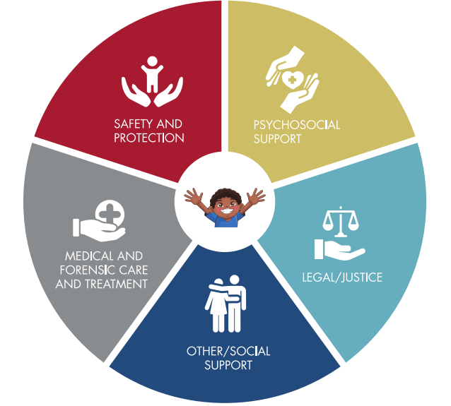
National Referral Networks
This slide sums up the considerations for violence during COVID
Consist of partnerships between different sectors, agencies, and government and nongovernmental services that coordinate to provide services, support, and access to justice for victims of violence and their families.
A comprehensive and well-publicized referral network helps providers quickly guide children, families to appropriate services and support.
*National referral pathways and the roles of duty bearers are discussed in webinar 5 in-depth session on VAC/VAW.
Notes:
Service provision to victims/survivors requires a holistic approach if all their needs are to be appropriately met. Specific services are provided by specific actors that would constitute a referral network in case management.

Slide 24
“Building back better”
As containment measures reduce, prioritize visiting households where violence suspected / identified
Case management – focus on living arrangements to reduce violence e.g. identifying new ‘safe’ caregivers or social networks
Keep violence prevention high on the agenda
Maintain referral networks or coordination that have worked during strict containment measures

Slide 25
Additional reading
UNICEF: COVID-19 Protecting Children from Violence, Abuse and Neglect in the Home. https://www.unicef.org/media/68711/file/COVID-19-Protecting-children-from-violence-abuse-and-neglect-in-home-2020.pdf
Inter-Agency Standing Committee, Global Protection Cluster, GBV Prevention and Response: GBV Risk Mitigation and COVID-19 Tip Sheet: https://gbvguidelines.org/wp/wp-content/uploads/2020/04/Interagency-GBV-risk-mitigation-and-Covid-tipsheet.pdf
Global Protection Cluster. Identifying & Mitigating Gender-based Violence Risks within the COVID-19 Response. https://gbvguidelines.org/wp/wp-content/uploads/2020/04/Interagency-GBV-risk-mitigation-and-Covid-tipsheet.pdf
Always check the Ministry of Health website for latest COVID-19 updates: https://www.health.go.ug/covid/
UNICEF: Protection of Children from Violence in the time of COVID-19. http://www.socialserviceworkforce.org/system/files/resource/files/Protecting-children-from-violence-in-time-of-COVID-English_2020.pdf
UNICEF Guidelines to Strengthen the SSW for Child Protection, Feb 2019 https://www.unicef.org/media/53851/file/Guidelines%20to%20strengthen%20social%20service%20for%20child%20protection%202019.pdf#page=17
INSPIRE Seven Strategies for Ending Violence Against Children. https://www.who.int/publications/i/item/inspire-seven-strategies-for-ending-violence-against-children
INSPIRE Handbook, Actions for implementing the seven strategies https://www.who.int/publications/i/item/inspire-handbook-action-for-implementing-the-seven-strategies-for-ending-violence-against-children

Slide 26
Breakout time!
Based on what you’ve learned in this webinar, what can we do to prevent and respond to violence during COVID-19?
Nominate one facilitator
Nominate one rapporteur
You have 10 minutes in your breakout room
Provide feedback on the three main points

Slide 27
Thank you!

Slide 28
Tea break! The zoom meeting will remain open for 20 minutes for anyone who wants an optional social catch up

