Slide 1

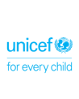

Webinar 5: Increased sexual and gender-based violence, domestic violence and violence against children under COVID- 19 and how to prevent and respond to it
Webinar Training
November 24, 2020

Slide 2
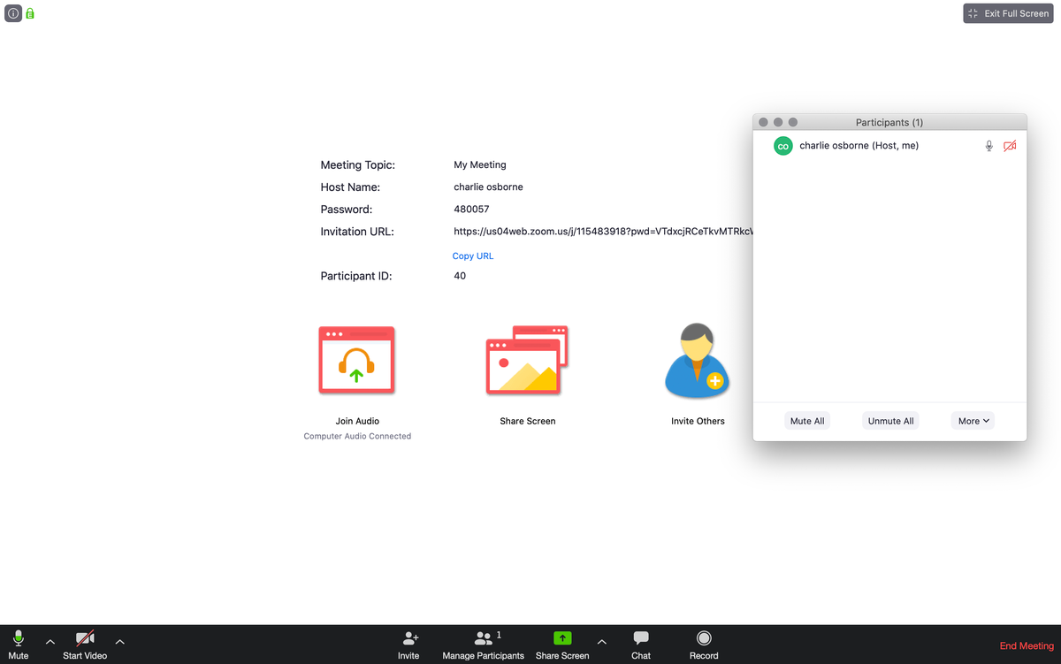
Before we start
Please keep your cameras off during the presentation section
The host will unmute your microphones before you go into breakout rooms so you can speak to each other in the breakout room
During the breakout and afterwards feel free to keep your camera on
We will leave time after the webinar for a ‘virtual tea break’

Slide 3

Agenda

Slide 4

Outline of Session
Session 1: Welcome and Introduction
Session 2: Overview GBV, VAC, VAW
Session 3: Relationship between GBV, VAC/W and power
Session 4: Cost of Violence
Session 5: GBV, VAC, VAW in context of COVID-19
Sesson 6: Mental health, stress and violence
Session 7: PSEA
Session 8: Protection of children during COVID-19
Session 9: How to respond
Session 10: Case Management & Referral Pathways

Slide 5

Learning Objectives
To identify the potential risks of different forms of violence against women and children and sexual and gender-based violence in the context of COVID-19,
To understand and review locally appropriate guidance, prevention and response actions

Slide 6
Welcome and introduction
Overall aim of this webinar:
Provide an Overview of the GBV, VAC, VAW in the context of COVID
Key principles informing the session
Strengths-based
Useful for here and now but also forward looking
Informed by global guidance and child rights instruments
Contextualized and fit for purpose (i.e., practical)
Participatory

Slide 7
A reminder: Structure of the webinars
Welcome (5 minutes)
Core technical topic ( 2hrs )
Breakout rooms ( 10 minutes)
Reflection (15 minutes)
Post-webinar survey (2 minutes)

Slide 8

Background and Definitions
Session 2

Slide 9
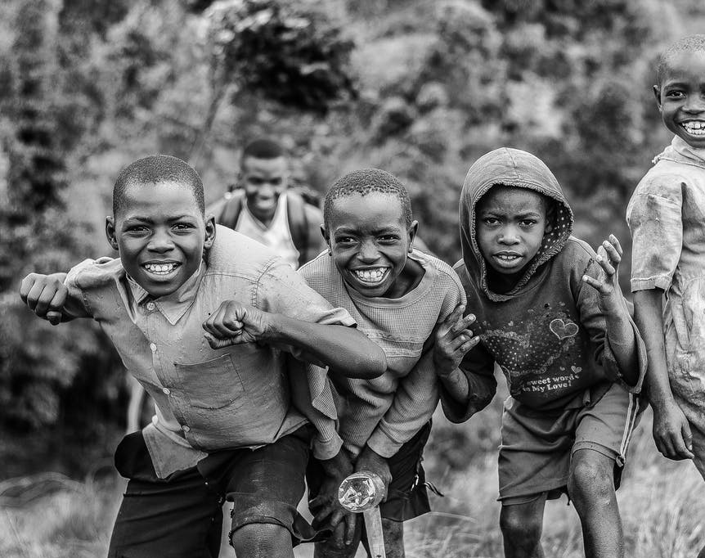
Definitions
The Children (Amendment) Act of 2016 Defines Violence Against Children as:
“any form of physical, emotional or mental injury or abuse, neglect, maltreatment and exploitation, including sexual abuse, intentional use of physical force or power, threatened or actual against an individual which may result in or has a high likelihood of resulting in injury, death, psychological harm, mal-development or deprivation.”

Slide 10
Violence definitions
Sexual and gender-based violence
Any sexual act that is perpetrated against a person’s will and is based on gender norms and unequal power relationships
Intimate partner violence
This refers to ongoing or past violence and abuse. It describes physical violence, sexual violence, stalking, or psychological harm by a current or former partner or spouse. It is the most common type of violence against women.
Notes:
Webinar guidance:
Explain that these are all Ugandan government definitions. If wished, can read out the sexual violence definition below.
Ask people if they have any questions about the definitions.
Optional, ask people if they think that all forms of gender-based violence are sexual violence?
Includes child marriage; female genital mutilation; forced marriage; forced wife inheritance; sexual violence within marriage; virginity testing; widow cleansing; damage to property; defilement; harassment; incest; intimidation; physical abuse; sexual abuse; stalking; verbal abuse
Perpetrated against men and women – in practice, most GBV perpetrated against women
Sexual violence is defined as including all forms of sexual abuse and sexual exploitation of children. This encompasses a range of acts, including completed non-consensual sex acts, attempted non-consensual sex acts, and abusive sexual contact. This also includes the exploitative use of children for sex. From - National Violence Against Children Survey; Findings from the Survey, MGLSD 2018.
Gender-based violence is violence directed against a person because of that person's gender or violence that affects persons of a particular gender disproportionately.
Source of definitions
Violence against children: Children Act (as amended) 2016, CAP 59. Act 9
Sexual Violence: National Violence Against Children Survey; Findings from the Survey, MGLSD 2018.

Slide 11

Overview: VAC/VAW
Session 2

Slide 12


Before we begin – Key Messages
Violence is never okay
GoU is committed to prevent violence against children (VAC) and women and sexual gender-based violence (SGBV).
Core function of the social service workforce (SSW): identify and prevent violence and support anyone at risk of or experiencing violence.
The workforce should use the power they hold positively to ensure safety of the survivor, refer & link survivors to appropriate services.
Notes:
The social service workforce (SSW) is a broad range of governmental and nongovernmental professionals and paraprofessionals who work with children, youth, adults, older persons, families and communities to ensure healthy development and well-being. It comprises a broad range of actors including but not limited to social workers, social educators, childcare workers, youth workers, child and youth care workers, community development workers/community liaison officers, community workers, welfare officers, social/cultural animators and case managers. http://www.socialserviceworkforce.org/workforce

Slide 13
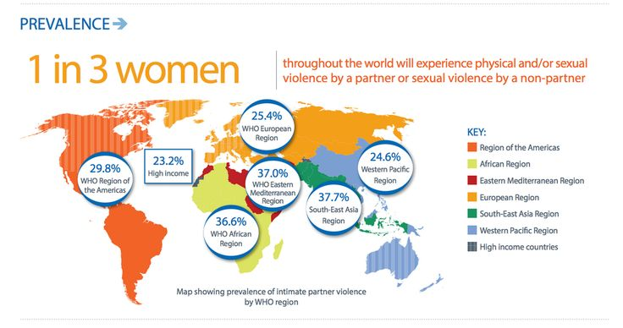
Overview: Violence Against Women
1 in 3 women worldwide has experienced physical and/or intimate partner violence (IPV) or non partner sexual violence in her lifetime (WHO 2013).
35% of women worldwide have experienced either physical and/or sexual intimate partner violence or non-partner sexual violence.
Globally, as many as 38% of all murders of women are committed by intimate partners
Women who have been physically or sexually abused by their partners report higher rates of several important health problems.
Notes:
UN Women - Facts and Figures: Ending Violence Against Women https://www.unwomen.org/en/what-we-do/ending-violence-against-women/facts-and-figures
World Health Organization. World Health Organization; Geneva: 2013. Global and regional estimates of violence against women: Prevalence and health effects of intimate partner violence and non-partner sexual violence.
https://apps.who.int/iris/bitstream/handle/10665/85239/9789241564625_eng.pdf;jsessionid=0EE32873F733D9C624C329744DBAF674?sequence=

Slide 14
Women who have experienced Intimate Partner Violence (IPV) are:
16% more likely to have a low-birth-weight baby; more than twice as likely to have an abortion; increased risk for unintended pregnancy, sexually transmitted infections, miscarriage; in some regions, are 1.5 times more likely to acquire HIV, as compared to women who have not experienced partner violence.
Poor mental health outcomes including post-traumatic stress disorder, depression, low self-esteem, and alcohol and drug abuse. Women who experience IPV are twice as likely to experience depression. (WHO, 2013)
Physical injury, disability, or even death (homicide and suicide) 42% of women who experience IPV report an injury because of the violence. (WHO, 2013)
Financial burden associated with obtaining medical and legal services, relocating, and/or seeking refuge from violence
Limits on earning potential because of injury or inability to work as a result of violence
Curtailed education achievement

Slide 15
Overview: Violence Against Children
Globally, nearly one in three adolescent girls aged 15 to 19 (84 million) have been the victims of emotional, physical and/or sexual violence perpetrated by their partners.
Most often, sexual violence against children is perpetrated by an adult known to the child – such as neighbour, family friend, stepfathers, uncles, cousin, brother, grandfathers and fathers)
Evidence shows that globally up to one billion children are affected by violence each year.
Across Africa, at least 50% of children between the ages of 2 and 17 years have experienced one or more forms of violence (excluding spanking, slapping and shaking) in all settings.
Gender dimension of VAC: girls experiencing more sexual violence, while boy experience more physical violence, however, sexual violence against boy is also under reported
Notes:
INSPIRE Seven Strategies for Ending Violence Against Children. https://www.who.int/publications/i/item/inspire-seven-strategies-for-ending-violence-against-children
Hillis, S., Mercy, J., Amobi, A., Kress, H. Global prevalence of past-year violence against children: A systematic review and minimum estimates. Paediatrics 2016:137 (3): e20154079.
Ibid

Slide 16
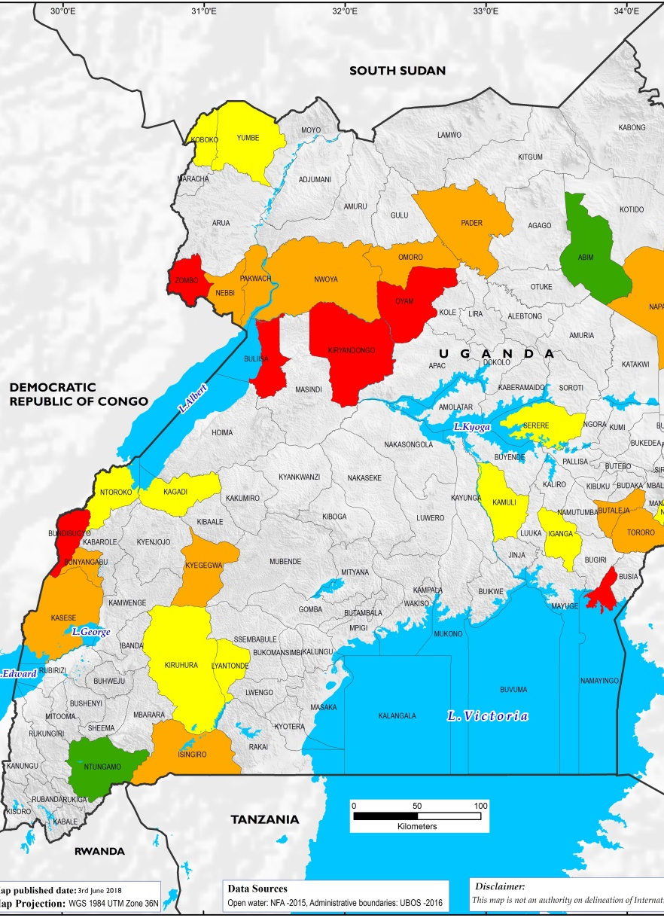
VAC/VAW and SGBV in Uganda
UDHS (2011) indicates that 56% of women aged between 15 and 49 years in Uganda have experienced physical violence at some point in life
27.8% of women in the same age group have experienced sexual violence, compared to 8.9% of men.
51 percent of women experience lifetime intimate partner abuse (UHDS, 2016)
In Uganda 35% (girls )and 17% (boys) youth had experienced sexual violence before the age of 18 (VACS Report, 2018)
Notes:
Though there is limited current nationwide data on violence against children and women, there are several partial studies and official statistics that provide an insight on the magnitude of different forms of VAC & VAW.
Indicated in the Uganda Demographic and Health Survey (UDHS) 2011, 2016
55 percent of female GBV survivors of sexual violence had the first sexual abuse before 19 years old.
According to the UDHS, 2016, 51 percent of women will experience physical or sexual intimate partner abuse in their lifetime. 35 percent have experienced it in 2016.

Slide 17
Relationship between power, gender and violence

Slide 18
Relationship between power, gender and violence
GBV is a result of an unequal balance of power between women and men, boys, and girls.
It cuts across cultures, ethnic groups, socioeconomic statuses, and religions.
Power is the capacity to empower or transform oneself and others.
Power is also a set of oppressive or unjust relations that emerge from every day social interaction.
Power can be negative or positive depending on how the person who wields it uses it.
Notes:
*Adapted from the Coordinating Comprehensive Care for Children (4Children) CPD on SGBV/VAC, 2020.
*Other info sources - Allen, Amy, 2016. "Feminist Perspectives on Power", The Stanford Encyclopedia of Philosophy
Adapted from the Coordinating Comprehensive Care for Children (4Children) CPD on SGBV/VAC, 2020
Power within
Is the strength that arises from inside ourselves when we recognize the equal ability within all of us to positively influence our own lives and community. By discovering the positive power within ourselves, we are compelled to address the negative uses of power that create injustice in our communities.
Power over
The power that one person or group uses to control another person or group. This control might come from direct violence or more indirectly, from childhood norms that position adults as superior to children or boys as superior to girls. Using one’s power over another is injustice.
Power with
The power felt when two or more people come together to do something that they could not do alone. It includes joining our power with individuals as well as groups to respond to injustice with positive energy and support.
Power to
The belief, energy and actions that individuals and groups use to create positive change. It is when individuals proactively work to ensure that all community members enjoy the full spectrum of human rights, and can achieve their full potential

Slide 19
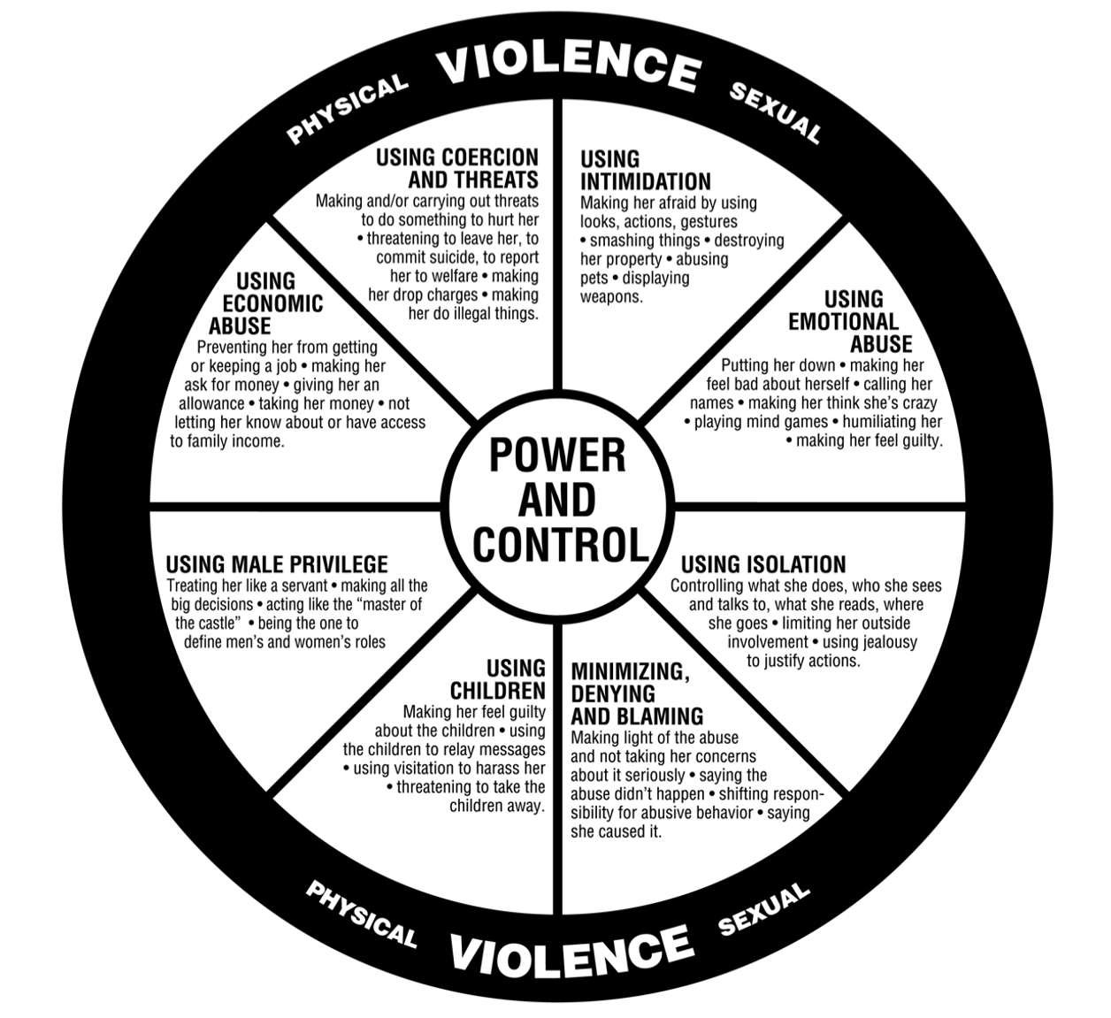
Power and Control Wheel https://www.theduluthmodel.org/wheels/
The Power & Control wheel is helpful tool in understanding the overall pattern of abusive and violent behaviours, which are used by a batterer to establish and maintain control over his/her partner. The videos (2.40 mins and 4.47mins) below provide an explanation for understanding of the power & control wheel. You can watch this in your free time.
https://youtube/5OrAdC6ySiY
https://www.youtube.com/watch?v=wO6BXV6Yxgo
In the chat box, share how you think power is linked to violence.

Slide 20
How we use Power
The negative use of power is the power we exert over others
Negative power is at the root of violence against women and children, and positive power holds the solution to turn the balance.
The SSW sometimes use power negatively to:
  Ask for money to provide a service
  Make false promises or provide false information on services available
  Connive with the perpetrator
  Decline to refer survivors of violence
  Leak confidential information to the perpetrator
  Intentionally falsify information
Notes:
Adapted from the Coordinating Comprehensive Care for Children (4Children) CPD on SGBV/VAC, 2020.

Slide 21
How we use Power
Positive use of power means we all become stronger, safer, and more respected within our relationships.
The SSW can transform negative uses of power into its positive use to facilitate prevention and effective response to VAC/W by:
  Ensuring safety of the survivor
  Referring and linking the survivor to appropriate services
  Respecting privacy of the survivor
  Involving the survivor in the helping process
  Documenting the case management process
  Prioritizing welfare needs of the survivor
Notes:
Adapted from the Coordinating Comprehensive Care for Children (4Children) CPD on SGBV/VAC, 2020.

Slide 22

Influence of cultural and social norms
Cultural practices and social norms about gender concerns (e.g. equality, equity, power relations, biases, stereotypes) and the acceptability of violence against women and children play a great role in violence in communities. These cultural practices and social norms include:
the normalization of violence
the justification of physical violence as an acceptable means of discipline
the low status of women and girls; belief that women and girls shouldn’t own land
the perception that violence is a “family” matter,
Forced and early marriage
Female genital mutilation (FGM)
All which discouragee survivors from seeking help.

Slide 23
Influence of cultural and social norms
VAC/GBV can be prevented through changing community norms about gender concerns through:
Scaling-up community mobilization programs to change violence related behavior and promoting more equitable relations between men and women through awareness creation, dissemination of IEC materials on VAC/GBV…
Holding perpetrators accountable rather blaming victims/survivors
Ensuring comprehensive response by mobilizing referral networks of service providers in the community to work together
Notes:
The cultural norms include: Forced and early marriage, Female genital mutilation (FGM), Belief that violence against women and children is acceptable, belief that women and girls shouldn’t own land, etc.

Slide 24

Questions?

Slide 25

Cost of Violence
Session 4

Slide 26
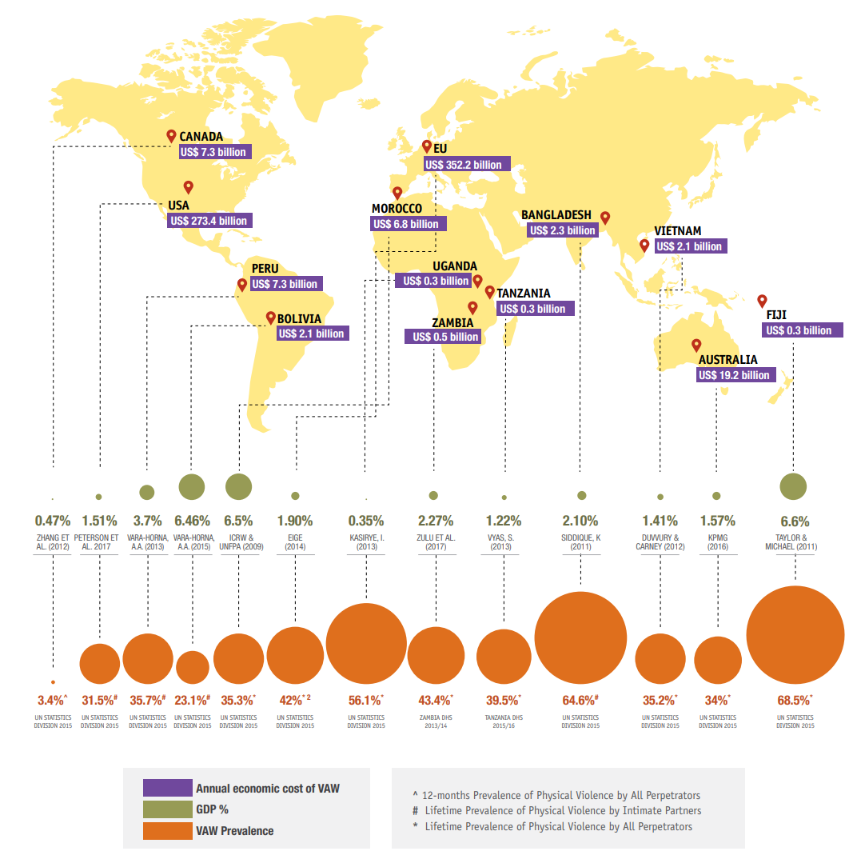
Cost of Violence
VAC/GBV has serious social and economic costs with short- and long-term effects.
The widespread burden of violence against women yields tremendous financial impact because of lost productivity and the cost of delivering services to survivors.
The global cost of violence against women has been estimated conservatively to be 2% of the global GDP, or US$1.5 trillion. (CARE, 2018)
In Uganda, for example, provision of public services to address domestic violence costs $US22.2 million, which represents 0.75% of the country’s national 2010/2011 budget. (CARE, 2018; Kasirye, 2012)
The cost of inaction is as high as the cost of violence.
Notes:
Information Source
ICRW; UNFPA, Intimate Partner Violence: High Costs to Households and Communities. 2009
https://www.icrw.org/wp-content/uploads/2016/10/Intimate-Partner-Violence-High-Cost-to-Households-and-Communities.pdf
CARE, COUNTING THE COST: The Price Society Pays for Violence Against Women, 2018

Slide 27
The Social cost of violence
Inhibits optimal brain development
Psychological behavioral problems
  Depression
  Anxiety
  Post-traumatic stress
  Suicide
  Self-harm
  Perpetuation of violence
  Risk-taking behavior (such as alcohol and drug use, delinquency, unsafe sexual practices)
Notes:
ICRW; UNFPA, Intimate Partner Violence: High Costs to Households and Communities. 2009
https://www.icrw.org/wp-content/uploads/2016/10/Intimate-Partner-Violence-High-Cost-to-Households-and-Communities.pdf

Slide 28
Economic cost of Violence
Broadly divided into two kinds:
Direct costs are more immediate and measurable
Indirect costs arise from the impact of violence

Slide 29
ECONOMIC cost of violence
Medical
Hospital inpatient / outpatient
Transport / ambulance
Physician
Drugs/ laboratory tests
Counseling
Non-medical
Policing and imprisonment
Legal services
Foster care
Private security
Direct Costs
Both direct and in-direct costs have short- and long-term effects
Tangible
Loss of productivity (earnings and time)
Lost investments in social capital
Life insurance
protection
Macroeconomic
In-Tangible
Health-related quality of life
- pain and suffering, psychological
Other quality of life
reduced job opportunities
access to schools and public services
participation in community life
Indirect costs

Slide 30
Questions?

Slide 31
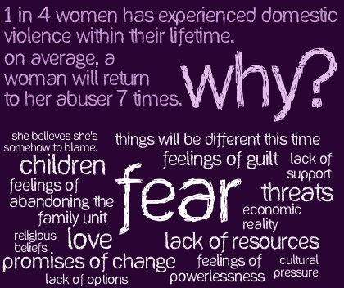
Increase of VAC/VAW during COVID-19
Session 5

Slide 32
Chat box
Take a few moments to think about the following question:
What do you think are/have been some of the impacts of COVID-19 on the situation of violence against children, violence against women and gender based violence?
Please either raise your hand and/or write in chat box

Slide 33
GBV VAC/W and GBV in the context of COVID-19
The current pandemic has amplified cases of domestic violence against women and girls globally and nationally:
Doubling or tripling of domestic violence calls to police / helplines and to Child Helplines in countries like China, France, Spain, Italy.
Domestic abuse killings more than doubled in first month of containment measures in the United Kingdom.
In Uganda, VAC/W and GBV cases progressively increased since the implementation of the containment measures begun.
Calls to the UCHL significantly increased since the implementation of the containment measures peaking with May with 41,977 calls (average of 1,354 calls a day).
Increase on GBV reports – 3,280 cases reported to the Uganda police between March and April with an additional 283 VAC cases.
Reports on VAC progressively increased since school closure with August seeing a 44% increase in reported VAC cases.
Notes:
Taub A. A New Covid-19 Crisis: Domestic Abuse Rises Worldwide. New York Times. April 6, 2020 https://www.nytimes.com/2020/04/06/world/coronavirus-domestic-violence.html
UCHL recorded 1902 reported cases violence - sexual violence (1152) and physical violence (750) against children from beginning of year
1.8 billion children live in 104 countries where violence response and prevention services have been disrupted due to COVID 19
Suicide cases registered by the Ugandan police. Suicide rates have increased by 20% in comparison to last year with 257 suicide cases (population between 17 – 48 years) recorded by August 2020.
https://capitalradio.co.ug/police-registers-increase-suicide-cases/
4. Ask people to note in the chat box if they have noticed any increased calls themselves. Ask them to note What types of violence they are noticing and how these are being reported

Slide 34
GBV VAC and GBV in the context of COVID-19
VAC/GBV has serious consequences for women’s and girls’ mental and physical well-being, including their reproductive and sexual health
It remains a social justice, human rights, and public health issue.
Domestic violence during the coronavirus disease (COVID-19) pandemic has been aptly described as a “shadow pandemic,” by the Executive Director of United Nations Entity for Gender Equality and the Empowerment of Women (UN Women).
Notes:
UN Women. Press release: Women Leaders Virtual Roundtable on COVID-19 and the Future issues call to put women and girls at the centre of response efforts. April 21, 2020

Slide 35

VAC and GBV linkages
  Partner abuse and child abuse often happen together
  Adult physical violence often accompanied by child neglect
Happen in same place
  Similar physical, emotional results
  Often exposure to different forms of violence makes consequences worse
Common consequences
Shared risk factors
  Gender inequality
  Economic stress, poverty, family pressures, alcohol, drugs
  Lack of supportive services
Inter-generational
  Partner violence impacts on child health & well-being
  Children experiencing VAC more likely to perpetrate and be victims of GBV as adults
Notes:
Amer, the information in this slide has been simplified from the following very useful article:
Alessandra Guedes, Sarah Bott, Claudia Garcia-Moreno andManuela Colombini. (2016). Violence Against Women and Violence Against Children – The Pointsof Intersection. Causes, consequences and solutions
https://www.paho.org/hq/index.php?option=com_docman&view=download&slug=day-4-vaw-vac-intersection-doc-lettersize-web&Itemid=270&lang=en

Slide 36
Why are levels of violence increasing during COVID-19 ?
Pathways linking pandemics & GBV and VAC
1. Economic insecurity and poverty-related stress
2. Quarantines & social isolation
3. Disaster & conflict-related unrest & instability
4. Exposure to exploitative relationships due to changing demographics
5. Reduced health services availability and access to first responders
6. Virus-specific sources of violence
7. Inability of women to temporarily escape abusive partners
8. Exposure to violence & coercion in response efforts
9. Violence perpetrated against health workers & CP staff
Pathways can be both direct & indirect, and are likely to interact, reinforcing existing vulnerabilities.
These pathways will depend on the type of vulnerability and contextual factors, including underlying gender norms and levels of GBV, VAW and VAC
Notes:
Economic insecurity and poverty-related stress: Poverty-related stress and economic insecurity correlate with poor coping strategies (e.g., substance abuse) can lead to increases in intimate partner violence and child maltreatment. When unemployment rates skyrocket and economies slow to a halt, VAW/C is likely to increase as a result of related stress.
Quarantines and social isolation: Close quarters, especially those tied to stressful conditions, are linked to stress, fear, poor mental health, and disorders, which can in turn increase the likelihood of VAW/C. Evidence focused on other crisis settings, including refugee camps and humanitarian assistance zones, confirms that when family members are in close proximity under conditions of duress for extended periods of time, rates of VAW/C are high. Quarantine also increases face-to-face exposure to perpetrators and can reinforce abuse tactics of social isolation.
Disaster- and conflict-related unrest and instability: Pandemics can break down social infrastructure, compounding existing weaknesses in conflict and disaster settings. This may lead to increased family separation, intra-familial violence, and exposure of women and children to unsafe conditions, including exposure to sexual violence and harassment as they seek to obtain basic goods, including food, firewood, and water.
Exposure to exploitative relationships due to changing demographics: Higher mortality rates drive extended family networks to care for orphans who have lost their parents to disease, creating new strains on households and risking a decreased quality of care, and even violence, directed at children. Changing family structures, combined with school closures and financial duress, can result in higher rates of exploitative, transactional sex among adolescent girls and higher fertility rates, with longer-term consequences for increased VAW/C.
Reduced health service availability and access to first responders: Health providers and emergency first responders are often the first point of contact for survivors, as well as sources of short-term physical protection for women and children. With all hands on deck needed to respond to pandemics, first responder resources and referral pathways that survivors rely on may not be available unless, following France’s example, intentional efforts are made to provide accessible points of assistance. In addition, women may avoid seeking health services for physical abuse and injuries, for fear of possible infection.
Virus-specific sources of violence: The COVID-19 pandemic has already documented ways perpetrators are using virus-specific misinformation and scare-tactics, as well as controlling behaviors to withhold safety items. In other pandemics, including the HIV/AIDS, violence has been linked to disclosure of serostatus, or may increase risk of lifelong exposure to violence due to coinciding disabilities (e.g. microcephaly within the Zika outbreak).
Inability of women to temporarily escape abusive partners: Women already face complex decisions and a wide range of barriers preventing their ability to safely escape abusive partners. In times of pandemic, when mobility is constrained, social distancing measures are imposed, economic vulnerability increases, and legal (social services) are scaled back, challenges in temporarily escaping abusive partners are exacerbated.
Exposure to violence and coercion in response efforts: There have been documented cases of aid workers responsible for assisting vulnerable populations in times of crisis committing acts of violence against women and children. Unequal power dynamics open up possibilities for those meant to help—including, as seen in the Ebola response, health workers, taxi drivers, and even burial teams—to pressure populations into exploitative relationships in exchange for transport, food, cash, and vaccines.
Violence against health care workers: Women make up nearly 70 percent of the global health workforce and are regularly subjected to abuse and harassment from colleagues and patients. Risks may be heightened in pandemic settings, harming women themselves and the crippling the effectiveness of broader health systems.

Slide 37

Relationship between stress, mental health and violence
Session 6

Slide 38
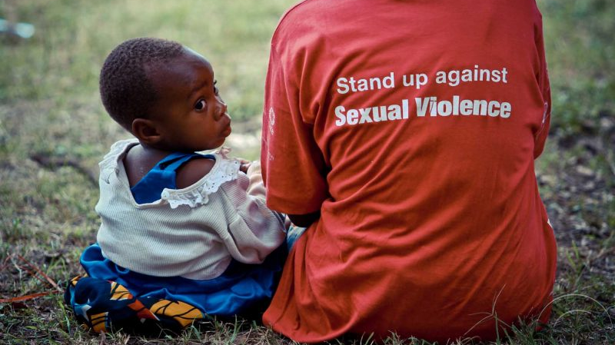
COVID-19, SGBV, VAC
Loss of income or reduced employment increases pressure and stress in the household and can result in:
Increased domestic violence and violence against women children
Psychosocial issues such as depression
Increased rates of children engaged in harmful labour, moving to the streets or early marriage
Increased child marriage-resulting from transactional sex, teenage pregnancies, etc.
Increase in FGM
Increased protection risks online

Slide 39
Relationship between stress, mental health and violence
Containment and social distancing measures can result in:
Closures of school, community or religious functions or venues, reduction in support services and limited access to safe spaces
Reduced avenues for reporting of VAC cases
Reduction in reporting and responding due to containment measures/barriers

Slide 40

Causes of stress under COVID-19
Stress is the body’s way of protecting you – you stay focused, energetic, and alert and this can save your life.
BUT too much stress starts causing major damage to your health, mood, productivity, relationships, and your quality of life.
Possible stress under COVID-19
Panic – fear of the future – out of control (when will it be normal again? What will be ‘normal’?)
Unpredictable change – working from home, virtual meetings, changing work procedures
Isolation from family and friends
Overwhelming responsibilities – work from home, caring for others, online schooling, possibly bereavement, feeling of not being able to help and assist your clients
Financial worries – loss of work, financial obligations
Uncertainty - When will it all end? When will schools reopen? When can I go back to my place of worship? When can I see my parents / children and friends/support network?

Slide 41
Additional factors
Additional stressors that may place women and children at risk of GBV/VAC include:
Impact of social isolation,
Exposure to economic and psychological stressors,
Increase in negative coping mechanisms (such as alcohol, drug misuse)
Inability to access usual support mechanisms or escape abusive households, owing to quarantine measures or travel restrictions.

Slide 42
COVID-19 is stressful for us all
For some, the experience can cause severe emotional distress.
For people already facing underlying mental illnesses the stresses can be greater.
Mental ill health and psychosocial distress are often invisible, and therefore no detected early.
With reduced access to services, it is essential for social workers and child protection practitioners to address mental health and PSS.

Slide 43
Adversity and mental health
When crises affect the lives of children’s and families, high levels of stress impact people’s lives.
Crises and adversity is a key risk factor for short- and long-term mental health issues.
Research on past epidemics has highlighted the negative impact of outbreaks of infectious diseases on people’s mental health (HIV, Ebola, SARS etc.).
Mental health is a neglected are of public health and community based interventions.
Notes:
UN policy brief on mental health and COVID-19: https://www.un.org/sites/un2.un.org/files/un_policy_brief-covid_and_mental_health_final.pdf

Slide 44
Questions?

Slide 45
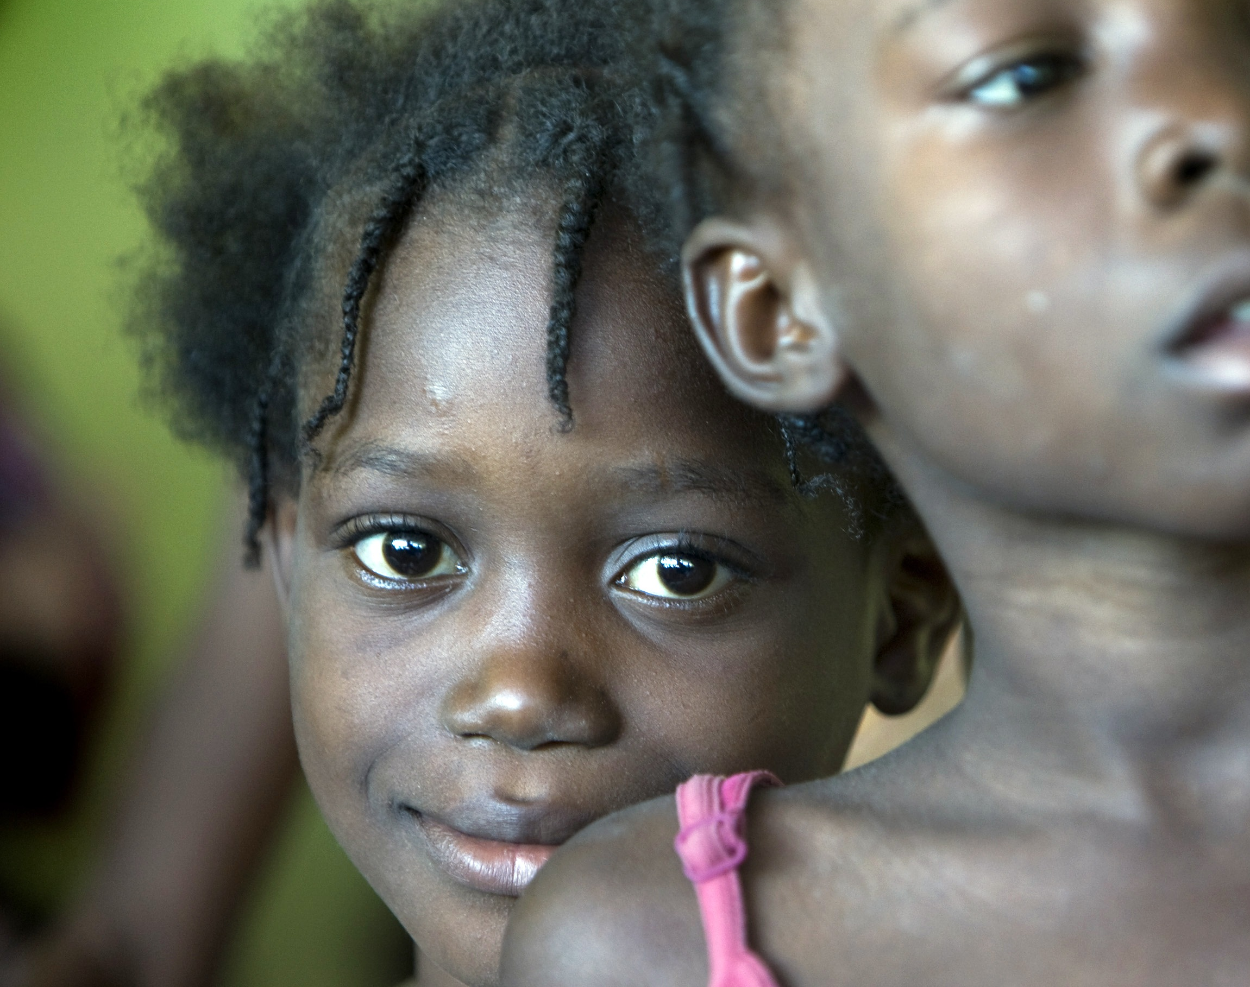
Protection against sexual exploitation and abuse by humanitarian workers
Session 7

Slide 47
Definitions based on the perpetrator
Sexual and Gender Based Violence: when the alleged perpetrator is from the community
Sexual Exploitation and Abuse (SEA): When the alleged perpetrator is affiliated with the UN or a humanitarian organization
Sexual Harassment: when the alleged perpetrator is a colleague
No difference in experience for the victim, but in humanitarian organisations and partners’ legal obligation to effectively respond if SEA occurs!

Slide 48
Film clip: no excuse for abuse: tacking SEA in humanitarian action
https://www.interaction.org/blog/no-excuse-for-abuse/

Slide 49
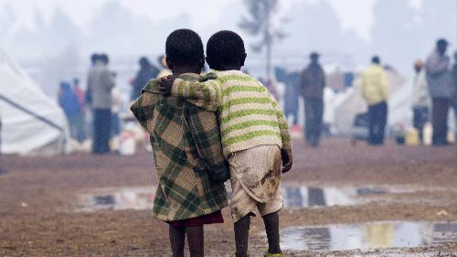
Protection against sexual exploitation and abuse by humanitarian workers (PSEA)
A violation of universally recognized international legal norms and standards.
SEA by humanitarian workers betrays the core values and principles of humanitarian action, fundamental to “do no harm,”
Destroys trust in the international humanitarian aid sector as a whole
It takes tremendous courage to report sexual exploitation and abuse, particularly in the face of an extreme power imbalance,
Evidence shows that the number of reported cases is only a small percentage of those that occur
Even when case reported, survivors – particularly in humanitarian contexts – face significant barriers to receiving the support and protection
Often perpetrators of such offences are not held accountable for their actions

Slide 50

Chat box
1.Why is this important to think of SEA in humanitarian situations?
2. Can you provide examples?

Slide 51

PSEA Timeline
2002 in West Africa a report finds abuse by NGO’s and UN Peacekeepers.
2002 IASC adopted 6 core principles intended to help with the prevention of SEA.
2003 The UN Secretary General produced a bulletin on SEA as well as the slogan “to serve with pride”. The Bulletin outlines the zero tolerance approach to SEA and Child abuse.
2008 Save the Children reported on Child protection issues in the sector.
2015 Independent review on SEA by international peacekeeping forces in the Central African Republic – ‘The CAR Panel Report’
In 2018, two major cases were brought forward:
  Oxfam – sexual exploitation of vulnerable people during the Haiti humanitarian response.
  Save the Children – Sexual harassment of women by senior staff.
2020 Allegations against a number of organizations personnel asking for sex in exchange for work in the Ebola response in DRC
Notes:
2018 IASC strategy: 3 main aims: 1) encouraging victims to come forward and a speak up culture;2) improving quality, survivor-centered support and protection; and 3) strengthened vetting, reference-checking, investigation processes and disciplinary measures.
3 priority outcomes:
Safe and accesible reporting
Surivior support
Enhanced accountability

Slide 52

The UN’s response and zero tolerance on SEA: a timeline
2003 SG’s Bulletin on Sexual Violence
2016 Trust Fund in Support of Victims of SEA
2017 UN victim’s Rights Advocate
2017 SG Whistleblower Protection Policy
2018 UN Protocol on Allegations of SEA involving implementing partners
2019 Revision of IASC 6 Core Principles
2019 IASC Plan for accelerating SEA in humanitarian response at country level

Slide 53
IASC Six guiding principles (based on SG’s Bulletin on sexual violence)
“Sexual exploitation and abuse by humanitarian workers constitute acts of gross misconduct and are therefore grounds for termination of employment.
Sexual activity with children (persons under the age of 18) is prohibited regardless of the age of majority or age of consent locally. Mistaken belief regarding the age of a child is not a defense.
Exchange of money, employment, goods, or services for sex, including sexual favours or other forms of humiliating, degrading or exploitative behaviour is prohibited. This includes exchange of assistance that is due to beneficiaries.
Any sexual relationship between those providing humanitarian assistance and protection and a person benefitting from such humanitarian assistance and protection that involves improper use of rank or position is prohibited. Such relationships undermine the credibility and integrity of humanitarian aid work.
Where a humanitarian worker develops concerns or suspicions regarding sexual abuse or exploitation by a fellow worker, whether in the same agency or not, he or she must report such concerns via established agency reporting mechanisms.
Humanitarian workers are obliged to create and maintain an environment which prevents sexual exploitation and abuse and promotes the implementation of their code of conduct. Managers at all levels have particular responsibilities to support and develop systems which maintain this environment.”

Slide 54
UN PROTOCOL ON ALLEGATIONS OF SEA INVOLVING IMPLEMENTING PARTNERS (2018): WHAT IT MEANS FOR UN’s Implementing Partners
Guiding Principles
The failure to address SEA through appropriate preventive measures, investigation and corrective action constitutes grounds for the termination of any cooperative arrangement with the UN
In addition, all UN partners must:
Adhere to the principles of ‘do no harm,’ confidentiality, safety and non-discrimination
Use a survivor-centered approach
Be guided by the best interests of the individual (child or adult) and the right of the individual to participate and to be heard.
Notes:
IPs must address SEA through appropriate preventive measures, investigation and corrective action. Failures to do so shall constitute grounds for the termination of any cooperative arrangement with the UN.
IPs must adhere to the principles of ‘do no harm,’ confidentiality, safety and non-discrimination when responding to allegations of sexual exploitation and abuse.
A victim-centered approach guides UN SEA prevention and response whereby the victim is informed, participates in the decision-making process and provides consent on the possible use and disclosure of their information.
In cases involving children, all decisions made regarding the prevention and response to SEA allegations involving implementing partners of the UN are guided by the best interests of the child and the right of the child to participate and to be heard.

Slide 55

Who are Implementing Partners?
UN Personnel and UN implementing partners
An entity to which a UN organization has entrusted the implementation of a programme and/or project specified in a signed document, along with the assumption of responsibility and accountability for the effective use of resources and the delivery of outputs. Implementing partners may include – but are not limited to - government institutions, inter-governmental organizations, and civil society organizations, including NGOs. Implementing partners’ subcontractors are subsumed within this definition.
Notes:
"UN Personnel” means staff members of the UN Secretariat or any UN System Organisation (including UNICEF), UN Volunteers working with any such organisation, people deployed to a UN System Organisation under Stand-by Personnel arrangements or on reimbursable loans, interns, people deployed to a UN System Organisation through an employment agency or similar arrangements, gratis personnel, and individuals who have a consultancy contract with a UN System Organisation, as well as international or regional military forces operating as part of a UN Peacekeeping Mission or otherwise under or associated with a UN mandate.
UN Implementing partner: an entity to which a UN office or entity has entrusted the implementation of a programme and/or project specified in a signed document, along with the assumption of responsibility and accountability for the effective use of resources and the delivery of outputs. Implementing partners may include – but are not limited to - government institutions, inter-governmental organizations, and civil society organizations, including NGOs. Implementing partners’ subcontractors are subsumed within this definition.

Slide 56
The work on PSEA in Uganda in the Covid-19 context
A national PSEA task force has been put in place that is chaired by a PSEA Coordinator hosted by the Resident Coordinator’s Office (head of the UN in Uganda).
Partnered with Sauti 116 to receive allegations of SEA.
Accelerate the work on:
  Access to safe and accessible reporting for every affected child and adult in humanitarian contexts.
  Quality and accessible SEA survivor assistance.
  Every child survivor of SEA has their case investigated in a prompt, safe and respectful way.
Ensure that all partners and their staff are trained on PSEA and the IASC six core principles.

Slide 57
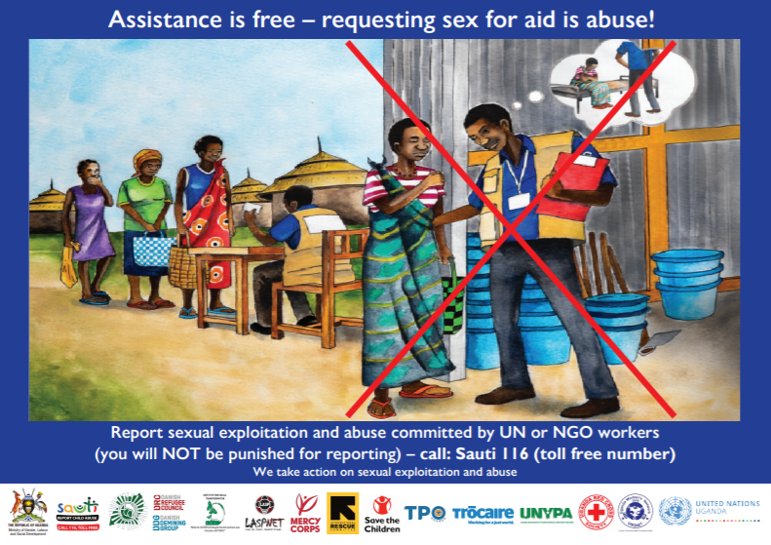
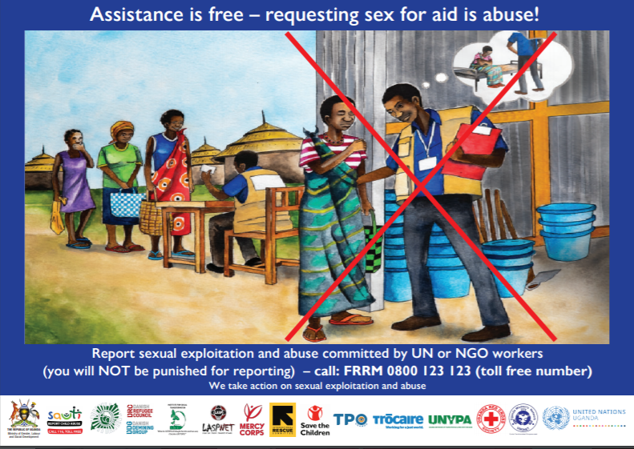
Ensure that partners and communities knows: 1) UN’s zero tolerance on SEA and;
2) where and how to report if SEA occurs.

Slide 58


Questions?

Slide 59
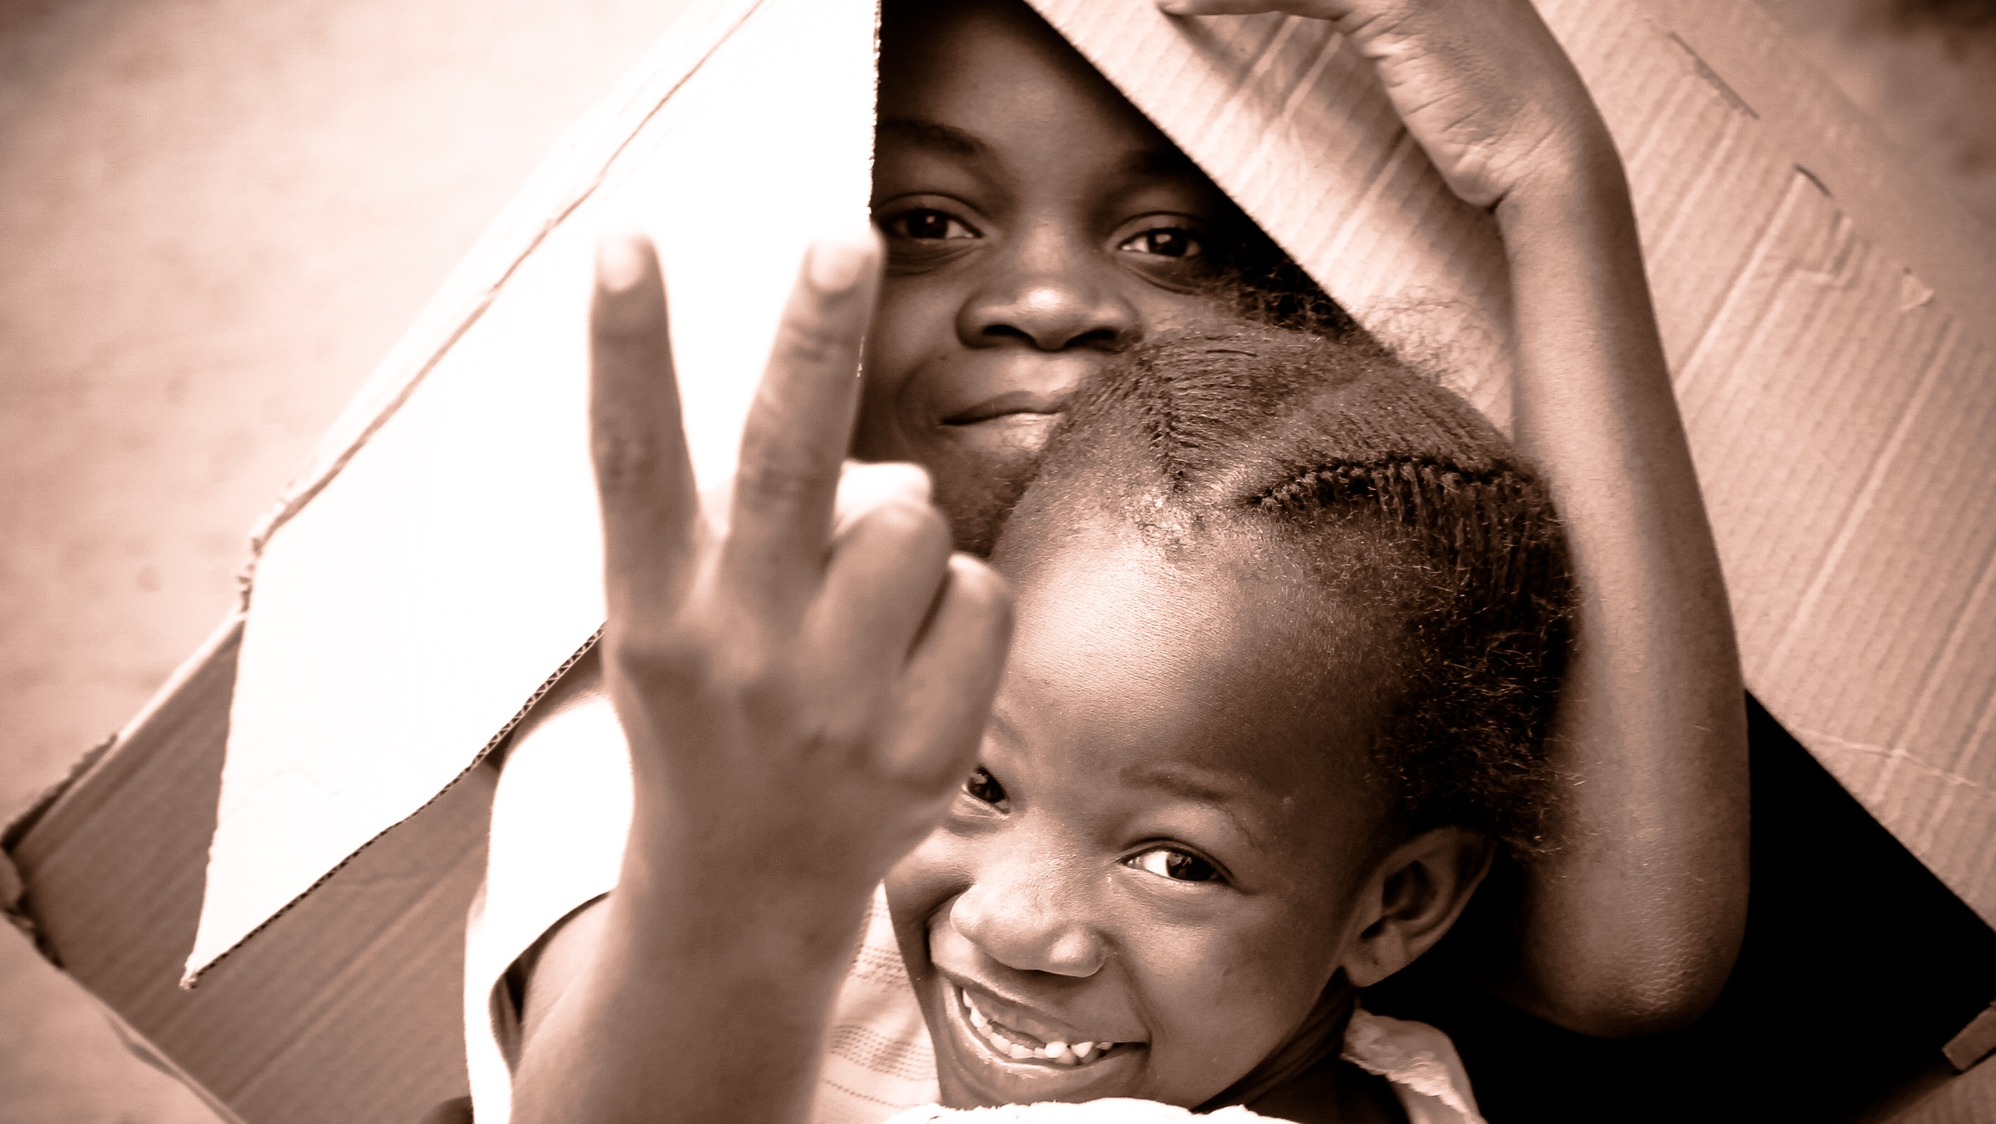
Protection of Children during COVID-19
Session 8

Slide 60

COVID-19 – increased risks for children
School closures interrupt school-based services and interventions for at-risk children
Greater difficulties in accessing health services,
Increased burdens and separation from caregivers (due to quarantines, or severe illness/death)
During quarantine measures children locked down with their perpetrators
Online abuse and sexual exploitation
Girls particular risk – SEA, child marriage, transactional sex
Lead to negative coping strategies

Slide 61

Protection of children during COVID
Provide a variety of accessible resources that support positive parenting, non-violent discipline, and positive coping and stress management skills to parents and caregivers including those who are the hardest to reach
Help children to re-establish a sense of their education routines through remote schooling and by working with public and private entities to provide children with access to educators and virtual learning platforms (e.g. internet access, laptops/tablets, radios, etc.) where possible.

Slide 62
Possible prevention interventions for VAC/GBV
Gender mainstreaming into existing programmes. (e.g., Adolescent health, school health programs, voluntary counselling and testing, care and treatment centres)
Strengthen positive cultural norms and practices; Helping communities organize SGBV and SVAC committees to reduce harmful traditional practices and norms contributing to S/GBV and VAC.
Advocate for and raising community awareness on various aspects of GBV and VAC, (e.g., intimate partner violence and other forms of violence against women, girls, men and children, gender equality and equity.)

Slide 63
Possible prevention interventions for VAC/GBV
Strengthen positive parenting; educating parents to increase their knowledge and understanding of how their own upbringing influences occurrence of VAC; eencourage age specific communication between parents and their children to enhance bonding.
Strengthen community networks (protection workforce, family (nuclear & extended), economic strengthening, and advocacy, psychosocial and medical support) through planning, training, and support.
Create open and functional dialogues with community members and groups about SGBV and VAC and its consequences.
Screen patients/clients to detect GBV and VAC.
Below is an 8.45-minute clip on strategies some actors are employing to prevent GBV/VAC.
https://youtu.be/CNzwJ9QvVfs
You can watch the clip later in your free time.
Notes:
The list of possible interventions is not exhaustive. Ask participants to include additional possible interventions in the chat box.

Slide 64

Additional considerations for prevention & response in the COVID context
Stay informed and prepared
Identify and assess
Act
Prevent further violence

Slide 65
Stay informed and prepared
Information
Keep yourself updated on the latest VAC/W and SGBV information
Services
Keep updated on local service provision
Contacts with health and police
Are local GBV services operating and, if so, on a normal schedule?
Are there local NGOs conducting violence prevention work?
Coordination
Coordinate with formal and community service providers and networks
Chiefs and religious institutions
Local FM stations and media
Police, health, education
Notes:
Coordination w/ non-GBV and non-CP actors
Update service mapping and referral pathways and disseminate using age-, language-, and disability- appropriate modalities
Training on signs/symptoms, how to handle disclosures, safe referral
Joint activities to reach child/adolescent survivors
Coordination w/ grassroots or community-based child protection networks, youth groups/networks, women-led organizations/networks, and disability-focused organizations/networks

Slide 66
Identify
Existing vulnerable children or families
Children and families living in precarious housing conditions
Children living without stable adult family care, refugee children, street-connected children
Adults or children living with disabilities
Encourage reporting from existing and new sources – let people know you are there for emergencies
Chiefs and religious institutions
Local FM stations and media
Police, health, education
Be aware of people who may be at greatest risk and proactively reach out
Do not proactively ‘look’ for cases of violence but be available and ready to support and act

Slide 67
Virtual assessment
Check
Check that the person can talk freely; if not, find a way to speak when it is safe
Ask if the person can speak freely
Do not pressure; give your number or ask them to text you to call back
Act
If there is a risk to life or safety, act
Referral procedures; liaison with police and health
Home visit if possible
Immediate link with supervisor
Be
Be aware that people may not disclose
Follow up and continue to be there
Provide Helpline information
Notes:
Verify if the person you are talking to can speak freely – e.g. “Are you fine talking now?” “Do you want to give me a missed call later when you can talk freely?” Continue to verify during the conversation
Once you have confirmed that the person is free to talk, review issues of safety and support.
Remind the client (adult or child) that the government allows travel to health clinics and police stations. Give advice about nearest health clinic and police station.

Slide 68
Action when you suspect or identify VAC or SGBV
Remember your own safety – protective clothing or access to soap and water
Standard case management practice
Take emergency action if needed
Record (case file, OVCIMS)
Report to supervisor
Ideally child protection officers are frontline service providers
If you cannot travel, identify health or police support
Be there! Offer immediate and ongoing support
Plan with child and family, e.g. if separation is essential
Ongoing counselling and support
If permitted, travel to meet at clinic
Maintain existing good practice e.g. avoid unnecessary separation
Notes:
Supporting existing survivors
Verify if the person you are talking to can speak freely – e.g. “Are you fine talking now?” “Do you want to give me a missed call later when you can talk freely?” Continue to verify during the conversation
Once you have confirmed that the person is free to talk, review issues of safety and support.
Remind the client (adult or child) that the government allows travel to health clinics and police stations. Give advice about nearest health clinic and police station.
If permitted, travel to meet client at clinic
If not urgent, schedule regular calls

Slide 69

Preventing further violence
Remember – violence is NEVER OK
  Include VAC and GBV messaging in COVID-19 awareness raising
Publicize helplines and hotlines
  MGLSD Child Helpline 116; Email sautichl@gmail.com (8am – 5pm); MGLSD Naguru Call Centre: 0800-199-195
  MoH: 0800-100-066 0800-203-033 0800-303-033
  Free counselling dial *252# (select option 10)
  Police Emergency hotline: 999/112
  0782 909153; 0772 460297; 0772 469 323
Psychosocial support and parenting tips
  Stress reduction tips (Session 7)
  Positive parenting (Session 11)
Safety planning with vulnerable clients
  Always check they can talk
  Help prepare safety plan (details in job aid)
  Schedule regular calls
Notes:
Supporting existing survivors
Put a poster outside the office or house
Announce on popular media outlets such as radios

Slide 70

How to respond: role of different sectors
Session 9

Slide 71
Role of different sectors
Many actors engaged in the prevention, response and management of VAC/VAC
Some play statutory roles and others non statutory roles.
It is important to know the role of each player for appropriate response and action
Build relationships and networks in your communities. They are critical to functioning referral systems especially during emergencies.
Involve local leaders, Religious leaders and teachers in disseminating key COVID-19 messages and VAC/SGBV messages. They hold positions of authority and trust & could play critical role in reporting incidences of violence.
Notes:
Statutory roles are played by actors such as the police, PSWO, magistrates/legal systems, medical personnel, teachers, etc. who are mandated by law to perform a specific set of functions. Some CSOs with legal mandates also play statutory roles.
Non- Statutory roles are usually played by CSOs, activist and advocates, child protection groups/communities, traditional leaders, etc.

Slide 72
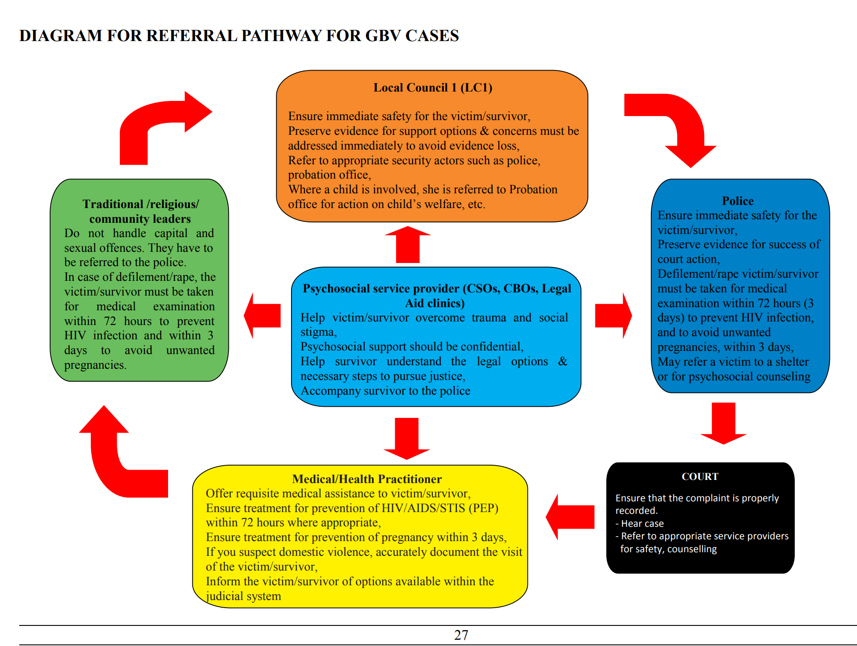
Role of sectors
The National Referral Pathways for Prevention and Response to GBV in Uganda provides an outline of roles for
local council (LC)1
the police
the Court
CSOs, CBOs and Legal Aid clinics
medical and health practitioners
traditional/religious and community leaders.

Slide 73

Session 10
Case Management and Referral Pathways

Slide 74

Break out Session
How would you describe case management?
Take 5 minutes to think about it, and share your answers in chatbox or raise your hand

Slide 75

What is Case Management?
Case management is a way of planning, organizing and carrying out work so that cases of vulnerable children, families, adults are handled in an appropriate, systematic and timely manner. It aims to ensure that through coordinated, collaborative care, clients can receive the services they need

Slide 76
Case Management
Case Management is: The process of identifying, assessing, planning, referring, and tracking referrals, and monitoring the delivery of services in a timely, context-sensitive, individualized, and client-centered manner

Slide 77
What Case Management is not
Case management is not a single event. It is not an intervention
It is not just checking boxes.
It is not about doing it for the child, adult, family.
It is not about making more work or creating a bigger burden for the social workers and community cadres.
It is about integrating a process based on good social work practice to support improved assessment, planning and stakeholder engagement

Slide 78
Enablers of an effective Case Management approach
Detailed legislative and policy framework that promotes the rights and interests of children.
Good knowledge of social work practice.
Partnerships to facilitate effective referral network/pathways.
Strong collaborative mechanisms.
Strong understanding of roles and responsibilities of all actors.
Strong institutional arrangements that support the approach and the system.

Slide 79
COVID and Priority Benchmarks
Survival and health: This priority area includes interventions to support the achievement of health outcomes to build health related knowledge and skills in caregivers and facilitate access to key health services, especially COVID-19, medical care and treatment services as a result of sexual abuse, GBV, VAC and FGM. Including nutrition of the affected person.
Economic stability and security: This priority area includes interventions that reduce economic vulnerability and increase resiliency in adolescents and families vulnerable and affected persons or families /care givers.
Care and protection of women and children: This includes issues of safety and security which should be prioritized to include interventions to prevent and mitigate violence against women and children, abuse, neglect and exploitation of children and adolescents including sexual and gender-based violence, online child sexual exploitation and abuse and child Labour.
Education and development: This priority area includes interventions which support children and adolescents during COVID-19 pandemic to overcome barriers to access to education; including enrolments, attendance, retention and progression and /or transition. It also addresses vocational training in the case of some adolescents as well as the aspects of integrated Early Childhood Development (ECD) such as early childhood stimulation activities.
Notes:
From MGLSD Guidance not eon IntegratdedCM by SSW (August 2020)

Slide 80
Case Management Considerations during COVID
While COVID-19 infection has lower mortality rate, it is highly contagious and demands higher level of flexibility, and a more layered approach to GBV case management service delivery than in past epidemics.
Case Management, by definition, functions as the central point that links children and families to multiple services
Case management remains a critical service that is possible to continue in most cases with sufficient modification and adaptations to uphold public health guidelines.
All duty bearers should:
Ensure that all service centers such as Police, shelters, GBV shelters have Infection, Prevention and Control (IPC) measures in accordance with standards at all service delivery points.
Communicate openly with women and girls about COVID-19 and any changes or potential changes in your methods of service delivery.
Notes:
‘GBV AOR Help Desk: GBV Case Management and the COVID-19 Pandemic’
https://gbvguidelines.org/wp/wp-content/uploads/2020/03/guidance-on-gbv-case-management-in-the-face-of-covid-19

Slide 81
Case Management Considerations during COVID
Meet
Meet with your team to discuss best options for remote support to survivors and remote support to staff.
Develop
Develop quick and clear new case management protocols with staff incase you move to remote support and consider modalities for remote case management supervision.
Strengthen
Strengthen staff capacity and confidence to provide remote support.
Keep up
Keep up to date on the latest guidelines from MoH. Follow protocols for infection, prevention and control at each stage and be ready for the situation to change quickly
Ensure
Ensure continued safe storage of sensitive documentation
Coordinate
Coordinate with other services providers.
Inform
Inform communities that you serve of possible changes ahead of time.
Notes:
‘GBV AOR Help Desk: GBV Case Management and the COVID-19 Pandemic’
https://gbvguidelines.org/wp/wp-content/uploads/2020/03/guidance-on-gbv-case-management-in-the-face-of-covid-19

Slide 82
Considerations for strengthening case management processes during COVID-19
Case Management process | Recovery period considerations
Identification | Remember to look for children in the hardest hit households Take note or recognize the vulnerable children, women or family affected by COVID-19, violence or any other emergency such as VAC, GBV, alternative care during the lockdown in the target area & who need support
Case Registration/enrolment | Register the case of the person affected by COVID-19, VAC, GBV, emergency or in need of alternative care after an assessment and prioritize the case for referral to appropriate services e.g. health care, mental health and psychosocial support, justice or education
Assessment | Obtain additional info re level of vulnerability Take advantage of eased social distancing and visit clients! Strengthen rapport! Physically/visually validate information you were not clear about.
Case Planning | Recognize children’s, adults’ & families’ resilience and highlight the new coping strategies they learned and practiced! Planning for longer-term and higher-level goals can resume. Support families to shape their new lives into something meaningful for them
Referrals | Ensure updated service provider lists are maintained – these will be a huge help going forward to the next phases of recovery Look for new economic strengthening and MHPSS initiatives
Monitoring | Take advantage of eased social distancing and visit clients! Strengthen rapport! Physically/visually validate information you were not clear about.
Case Closure | It is important to close cases in a safe but timely way, to ensure proper case load management
Supervision | Continue to provide supportive supervision, ensuring that case workers are able to adjust well to new case management considerations during recovery - Remember – case workers will also be personally adjusting and your support will be critical

Slide 83
Additonal Guidance
MGLSD GUIDANCE NOTE FOR THE SOCIAL SERVICE WORKFORCE TO DELIVER INTEGRATED CASE MANAGEMENT DURING THE COVID-19 QUARANTINE PERIOD
August 2020

Slide 84
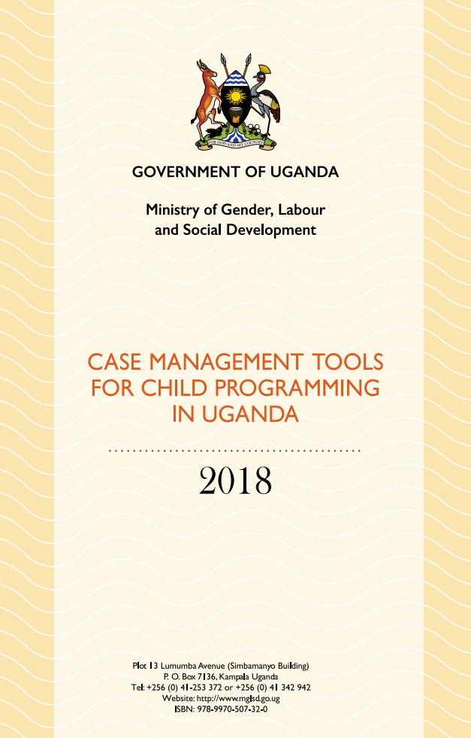
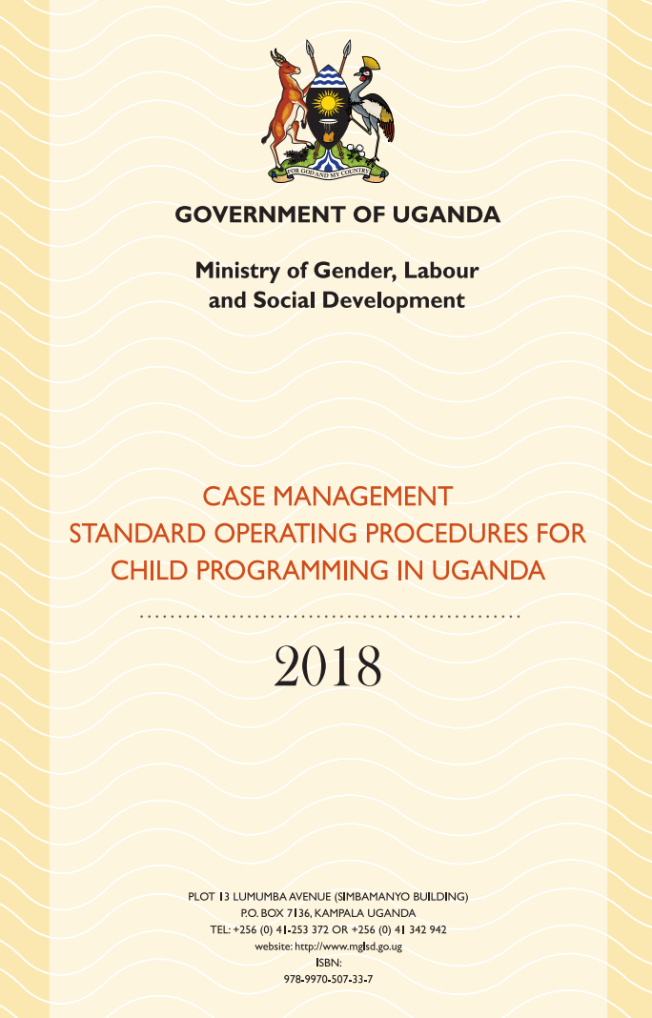
Case Management beyond COVID-19
MGLSD case management SOPs and Tools to guide the case management for child programming
These are both hard copies and electronic formats
They are uploaded on the OVCMIS and the SSW App and can be downloaded for free.
For additional reading, access the free MGLSD/Makerere online eLearning training on case management and use of the tools. https://mglsd.somesa.ug
Notes:
Looking Beyond COVID-19, there are readily available government resources and tools that CSOs and the SSW can use in their programming. The standardized case management SOPs and Tools was launched by MGLSD in 2019.

Slide 85
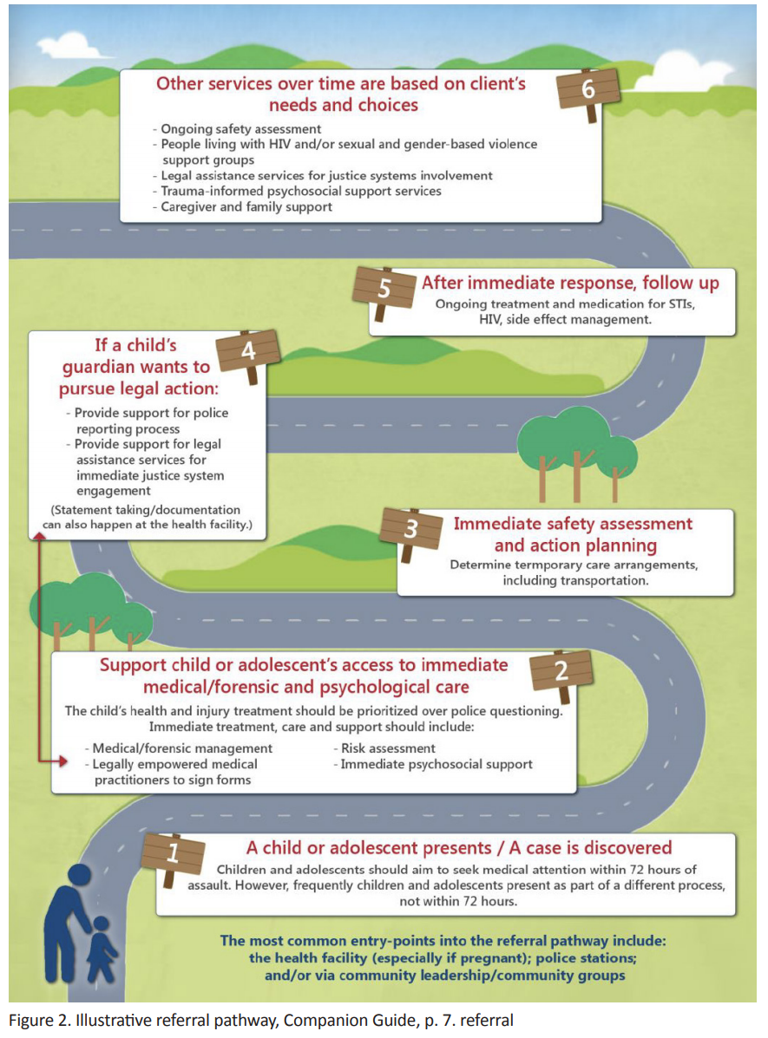
Referral Pathways and Protocols
Referral: Recommendation given to a survivor for further care to other service providers.
Referral pathway: Is a system by which transfer of care is done from one service provider to another on a timely basis.
Protocols: an official set of rules /procedures that explain the correct conduct and procedures to be followed in formal situations.
Service provider: Refers to public and private company or institution that provide essential services to the victim/survivor of GBV, and whose objectives include protection of the rights of the victim/survivor.

Slide 86

Referrals and Referral Pathways and Protocols
Key considerations for effective referrals in the management of GBV
Ensure that quality services (survivor/victim centred services) are offered at the places you are referring clients.
Make sure the survivor/victim gives informed consent for any referrals you make and any information you disclose to other services.
Have updated referral pathway, for when the survivor consents to referrals.
Fully understand the GBV response mechanism and referral pathway to make effective referral

Slide 87
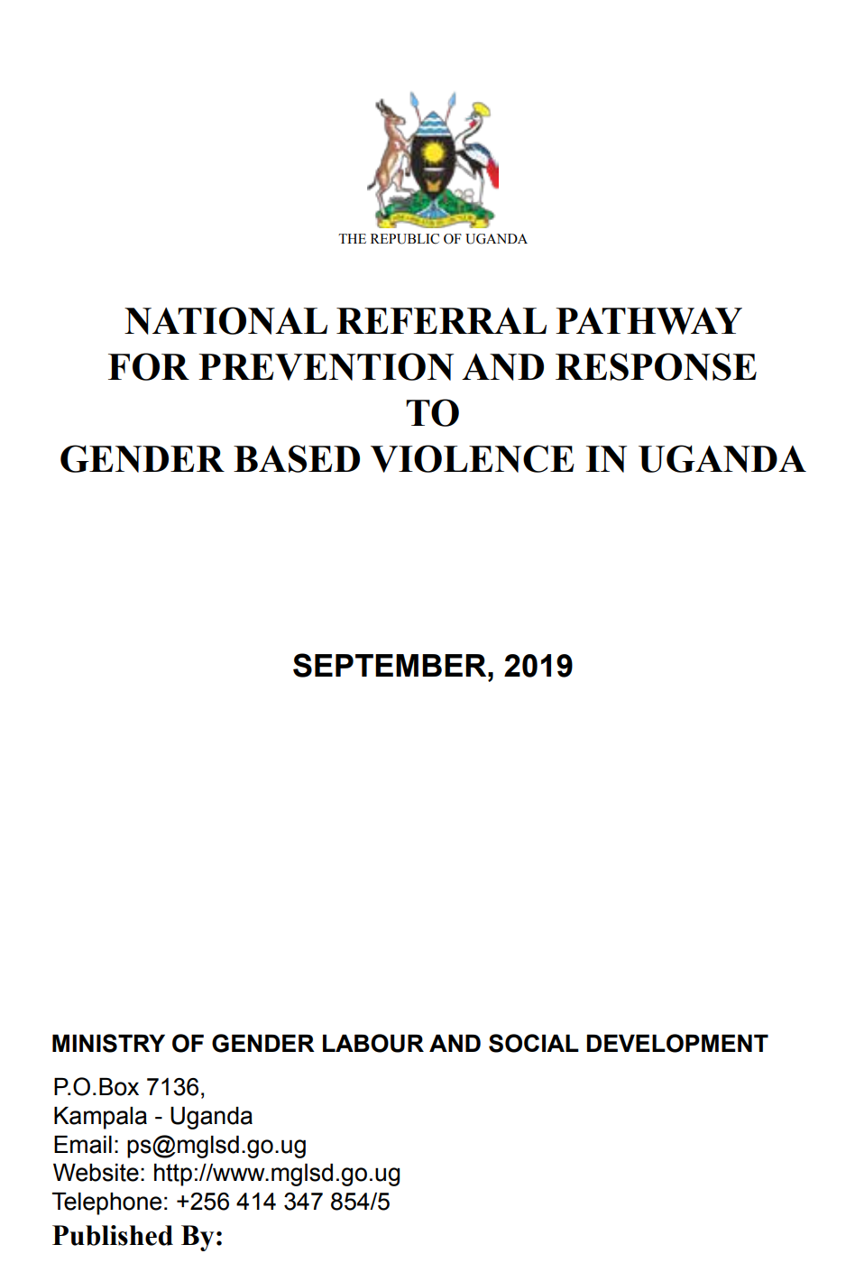
MGLSD’s GBV referral pathways
The MGLSD National Referral Pathway for prevention and response to GBV in Uganda offers several pathways for several depending on the victim/survivor’s entry point to the service provider.
It offers five pathways at these entry points:
  Police
  Psychosocial service provider
  Health practitioner
  Community leaders/CSO…
  Magistrate
Notes:
Information Source: National Referral Pathway For Prevention And Response To Gender Based Violence, Sept 2019.

Slide 88
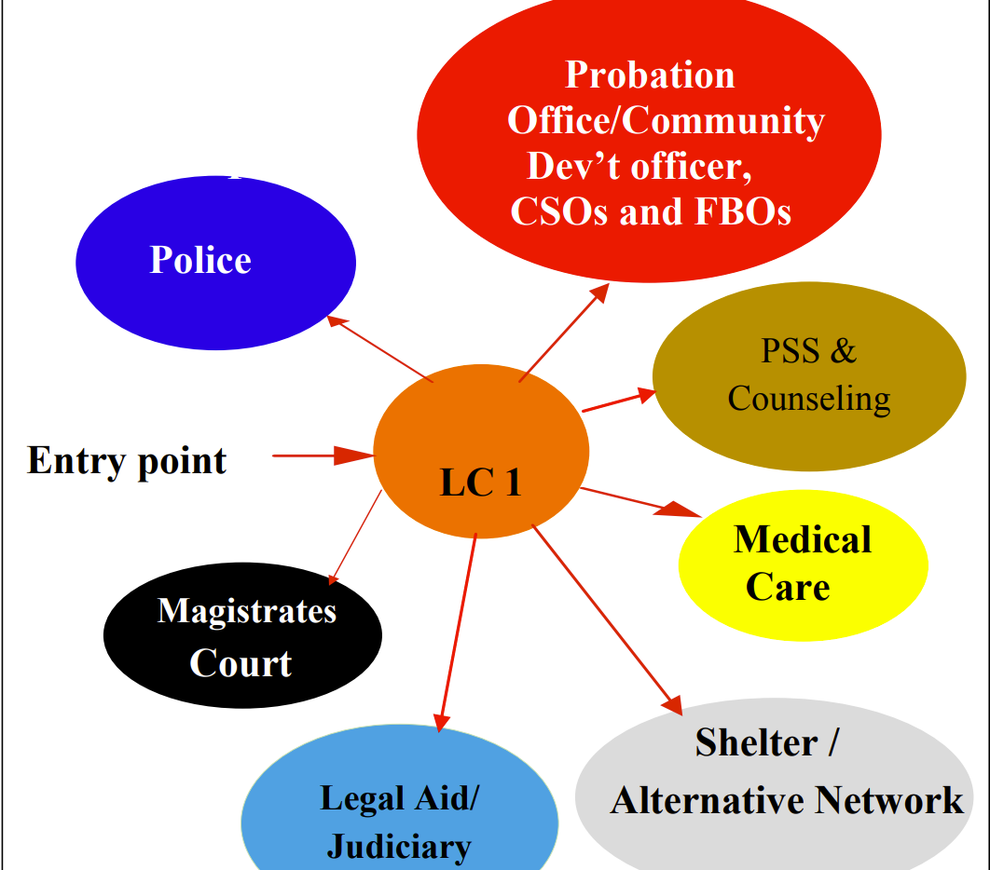
Reporting and Referral Pathway
Local Council 1
Hears cases of physical assault without injuries, economic violence verbal and emotional abuse.
TheLC1 should not handle any cases related to; any form of sexual offence; when the offender is likely to commit further harm to the victim or relative; and when there is a pattern or escalation of violence. These cases must be reported directly to the police
When the community or the victim/ survivor reports the case to LC1; The LC can mediate and where mediation fails, it hears the case as a court. The decision of the court is reached by a consensus.
Where a child is involved, the case must be referred to the Probation office for further action.
LC court may make a written referral to Police or Magistrate where perpetrator is a repeat offender.
*Please refer to the Local Council Act, 2006 for details on the role of the LC1.
Notes:
Sexual offence include rape, defilement, attempted rape and or defilement and sodomy.

Slide 89
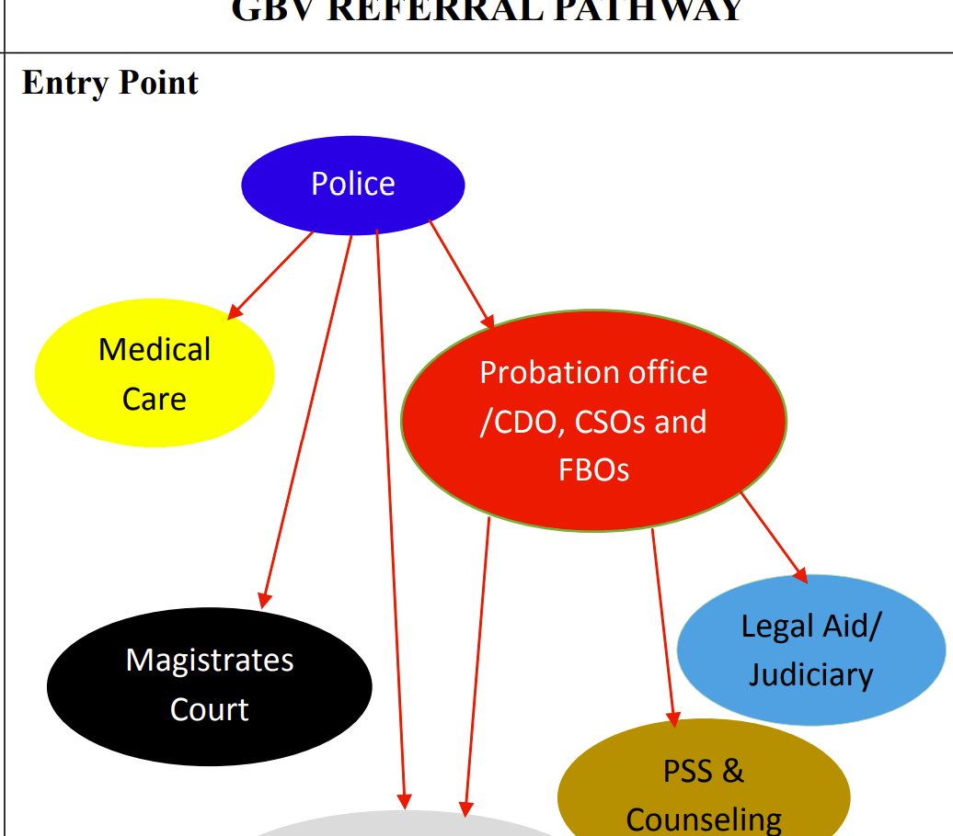
Reporting and Referral Pathway
Police
All capital offences, or offences where the outcome is grievous bodily harm (GBH) such as rape, aggravated defilement, attempted rape and or defilement and sodomy
For the health and well being of the victim and in order to ensure the ‘purity’ of the evidence these cases must be immediately reported to the medical examiner or health practitioner.
Notes:
Police officer fills in part PF3A, gives victim/survivor a reference number, and refers her to a medical/ health practitioner.
Victim/survivor is examined, and medical practitioner fills in part (b) of PF3A
If it is a sexual assault case, the police fill in part (a) of PF24A and the medical practitioner fills in part b of the PF24A.

Slide 90
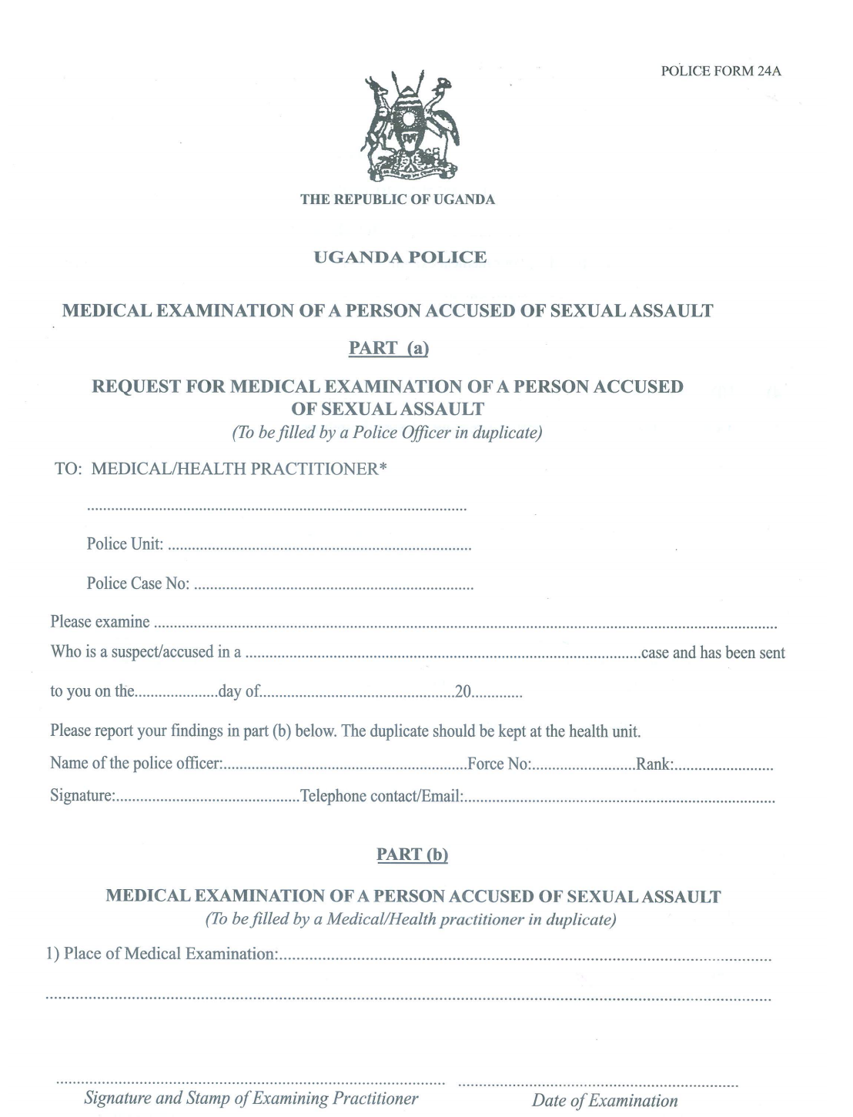
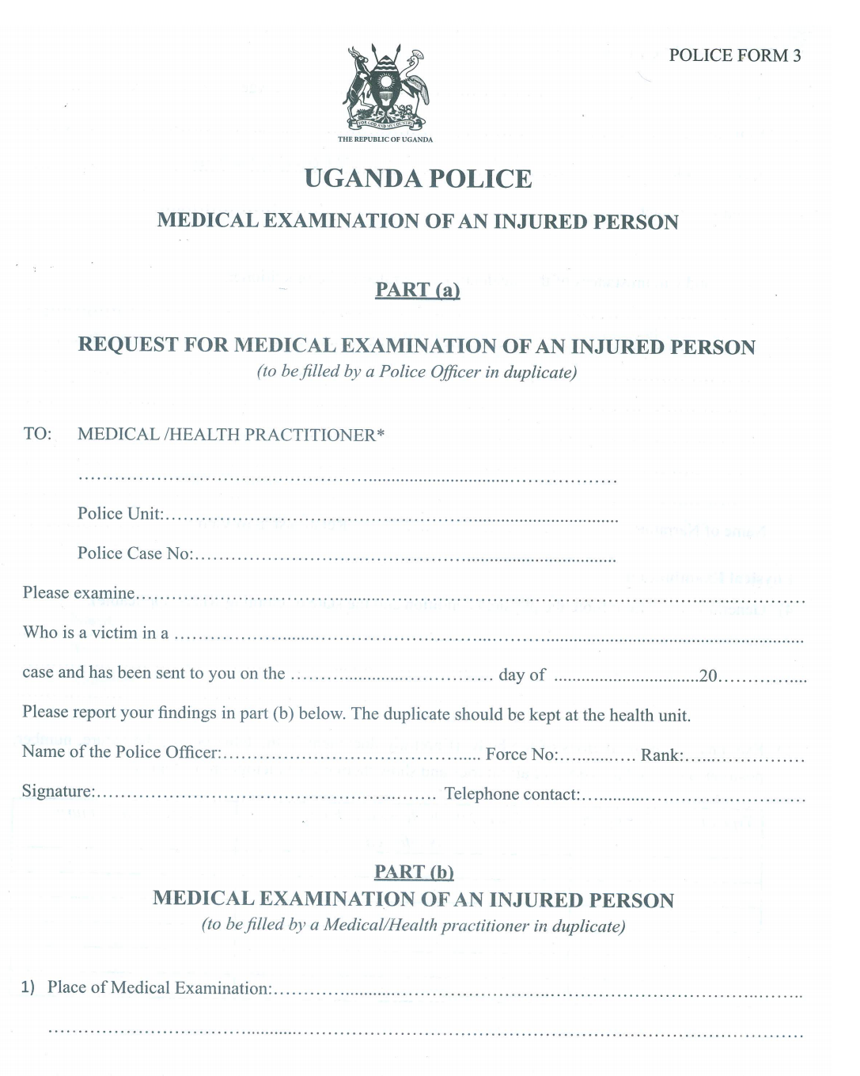
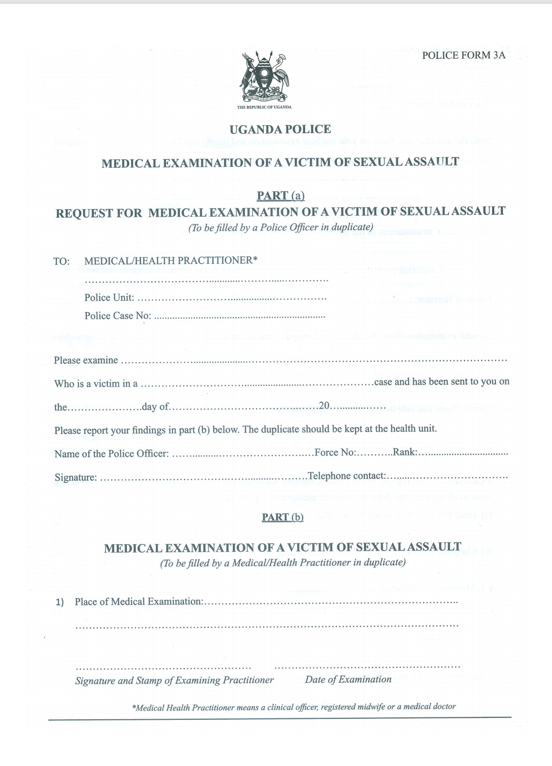
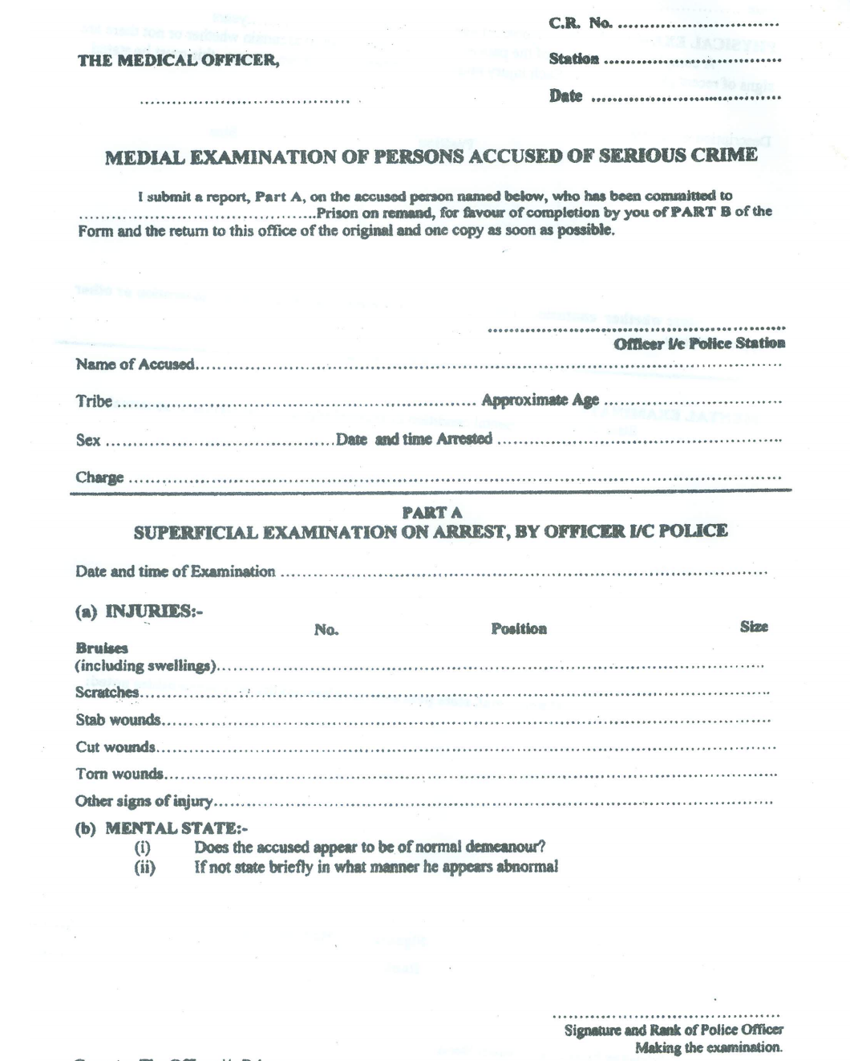
Forms: 3, 3A, 24, 24A
These forms are critical in management of VAC/GBV cases in addition to other case management forms.
Notes:
Police form 3 – Medical examination of an injured person
Police form 3A – Medical examination of a victim of sexual assault
Police form 24 – Medical examination of persons accused of serious crime
Police form 24A - Medical examination of a person accused of sexual assault.
The police forms can be downloaded from the Uganda Police Force (UPF) website at http://www.upf.go.ug
https://www.upf.go.ug/download/medical-examination-of-a-victim-of-sexual-assault-police-form-3a/

Slide 91
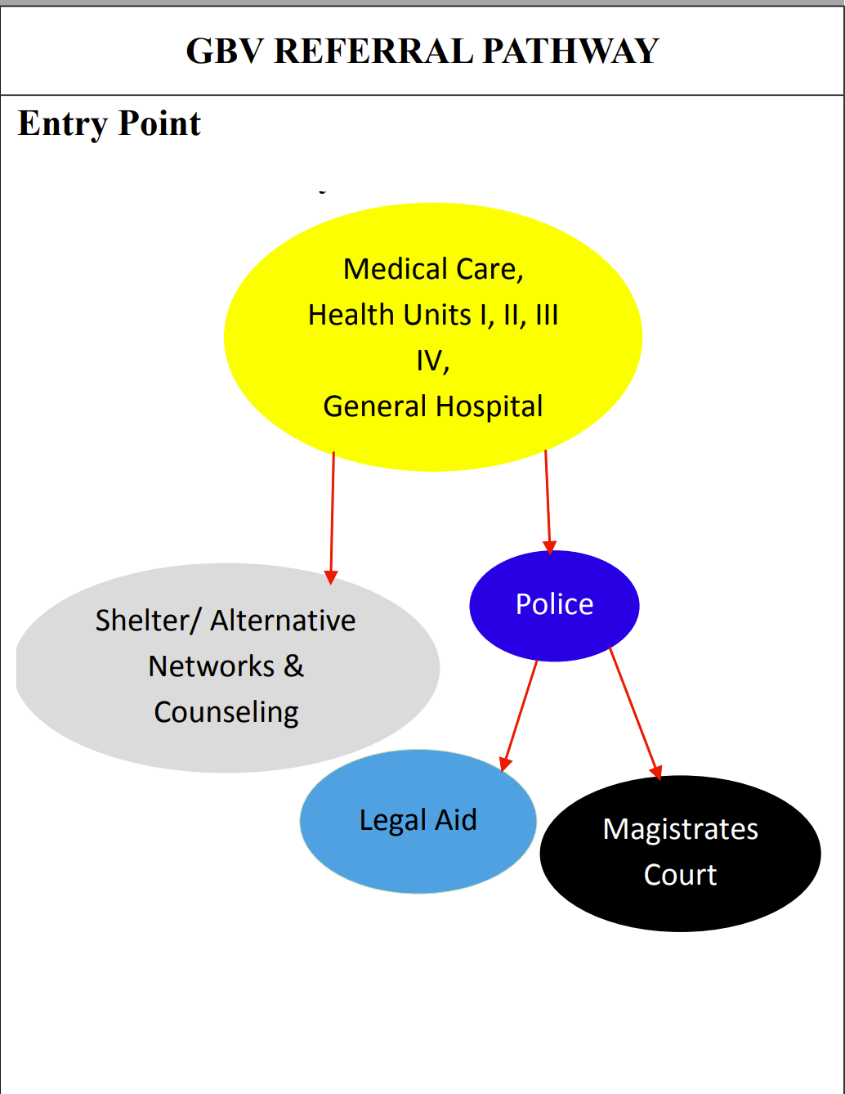
Reporting and Referral Pathway
Health
Where the physical condition is critical:
The victim/survivor must be taken for medical care before reporting to police.
Collaborate with the police to ensure criminal process (Form 3A and 24A) are completed.
PEP and ECP must be offered to the victim or survivor for preventative purposes
Referral to most appropriate service provider for PSS, support and counselling

Slide 92
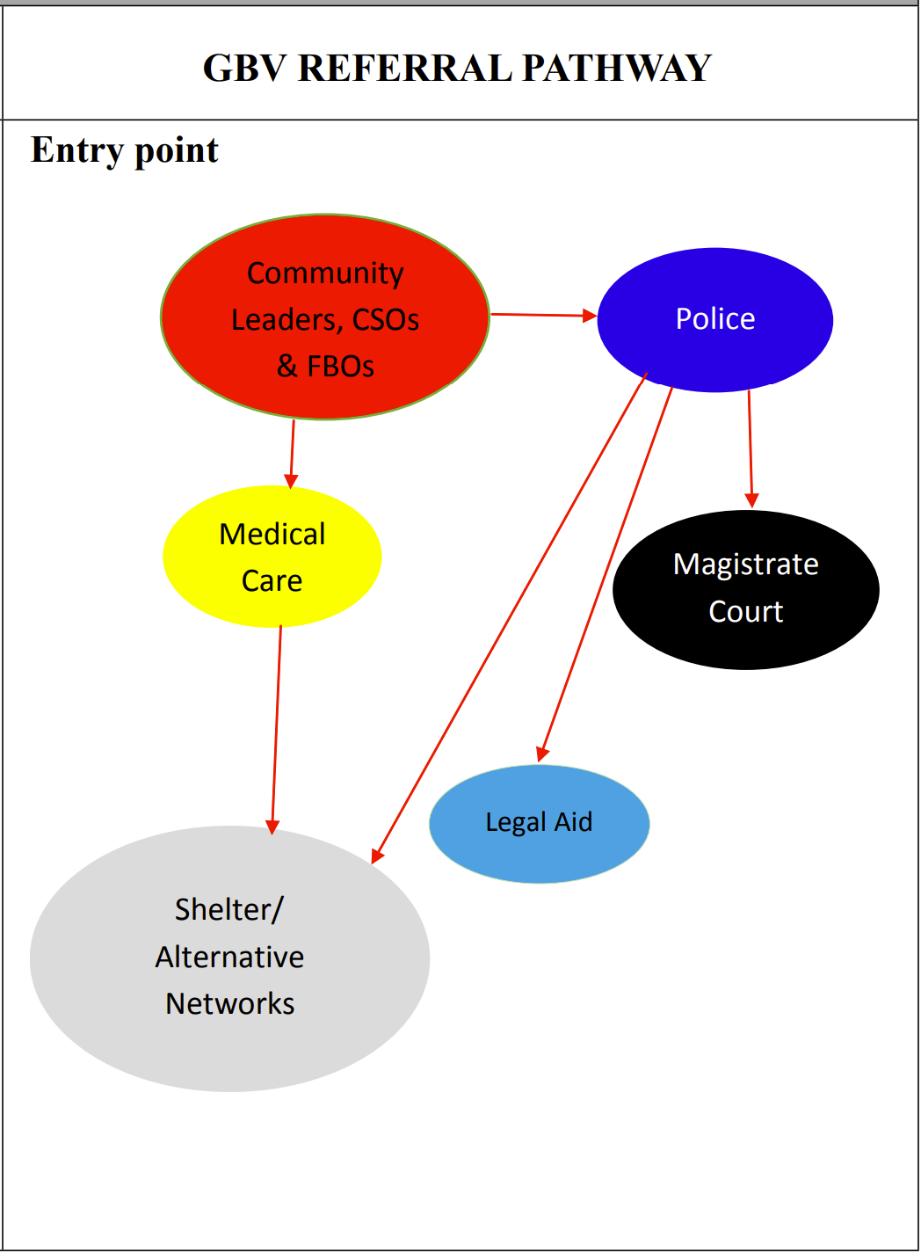
Reporting and Referral Pathway
Traditional; religious/community leaders, CSO
Handle cases of economic violence verbal and emotional abuse
Must refer victims/survivors to appropriate service provider for follow up if necessary.
Notes:
Sexual offence include rape, defilement, attempted rape and or defilement and sodomy

Slide 93
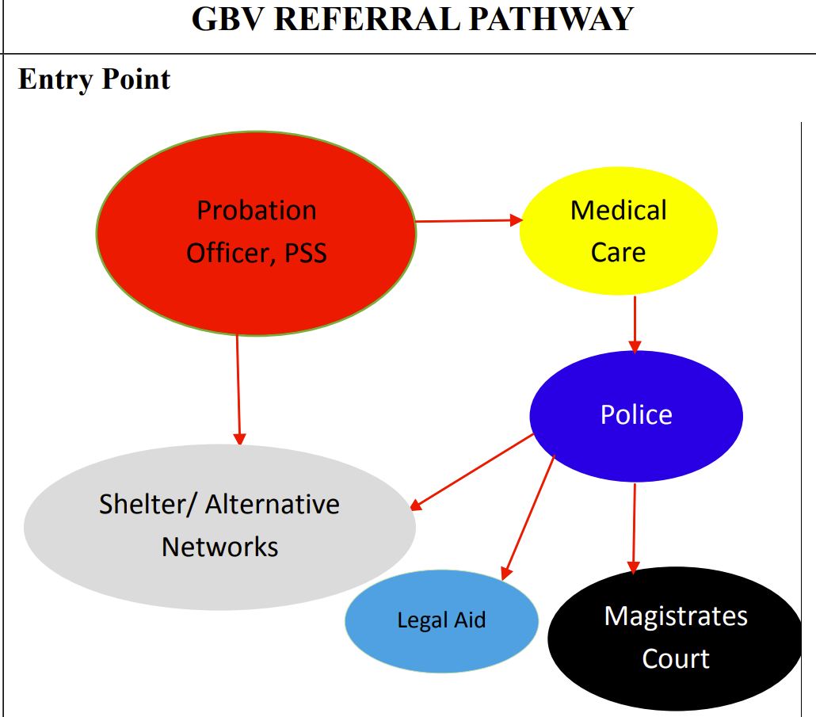
Reporting and Referral Pathway
PSS (Probation, CSO; CBO; PO; Legal aid)
The victim/survivor may report to any PSS service provider,
Ensure that the correct referral pathway is followed, depending on the nature of the case, either for medical attention and or criminal intervention
Ensure that the case management process is initiated.

Slide 94
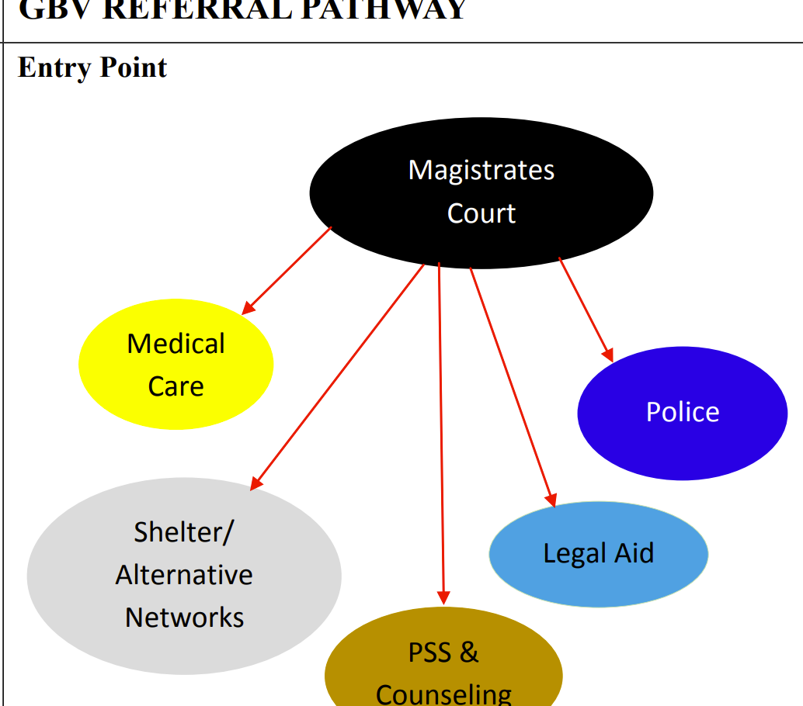
Reporting and Referral Pathway
Magistrate
A victim/survivor can report directly to a magistrate court.
The court may refer the victim/survivor to a shelter or medical care.
When the victim/survivor reports to the court
A victim’s complaint is recorded in writing The court summons are issued to the perpetrator
Court hears the case to its conclusion
*Refer to the Magistrate’s Act 2006 for more detail

Slide 95

Guidelines and tips for improving referral pathways
Coordinate the dissemination of information on available child protection services and reporting mechanisms across social, education, health, law enforcement and other relevant sectors.
Ensure that strategies developed to address child protection concerns include practical responses to deal with actual or imminent harm, negative coping strategies (e.g. substance abuse, early and forced marriage, etc.), mental health and other needs identified through joint assessments.
Create awareness of the different helplines available and how to contact them
Know your referral network and build a good working relationship with the network in your community.

Slide 96
“Building back better”
As containment measures reduce, prioritize visiting households where violence suspected / identified
Case management – focus on living arrangements to reduce violence e.g. identifying new ‘safe’ caregivers or social networks
Keep violence prevention high on the agenda!
Maintain referral networks or coordination that have worked during strict containment measures

Slide 97
Additional reading
UNICEF: COVID-19 Protecting Children from Violence, Abuse and Neglect in the Home. https://www.unicef.org/media/68711/file/COVID-19-Protecting-children-from-violence-abuse-and-neglect-in-home-2020.pdf
Inter-Agency Standing Committee, Global Protection Cluster, GBV Prevention and Response: GBV Risk Mitigation and COVID-19 Tip Sheet: https://gbvguidelines.org/wp/wp-content/uploads/2020/04/Interagency-GBV-risk-mitigation-and-Covid-tipsheet.pdf
Global Protection Cluster. Identifying & Mitigating Gender-based Violence Risks within the COVID-19 Response. https://gbvguidelines.org/wp/wp-content/uploads/2020/04/Interagency-GBV-risk-mitigation-and-Covid-tipsheet.pdf
Always check the Ministry of Health website for latest COVID-19 updates: https://www.health.go.ug/covid/
UNICEF: Protection of Children from Violence in the time of COVID-19. http://www.socialserviceworkforce.org/system/files/resource/files/Protecting-children-from-violence-in-time-of-COVID-English_2020.pdf
UNICEF Guidelines to Strengthen the SSW for Child Protection, Feb 2019 https://www.unicef.org/media/53851/file/Guidelines%20to%20strengthen%20social%20service%20for%20child%20protection%202019.pdf#page=17
INSPIRE Seven Strategies for Ending Violence Against Children. https://www.who.int/publications/i/item/inspire-seven-strategies-for-ending-violence-against-children
INSPIRE Handbook, Actions for implementing the seven strategies https://www.who.int/publications/i/item/inspire-handbook-action-for-implementing-the-seven-strategies-for-ending-violence-against-children

Slide 98
Additional reading
IASC Interim Guidance on COVID-19: Protection from Sexual Exploitaiton and Abuse\
IASC Interi Guidance Checklsit ot protect form SEA during COVID-19
https://psea.interagencystandingcommittee.org/
https://interagencystandingcommittee.org/iasc-learning-package-protection-sexual-misconduct-un-partner-organizations

Slide 99
Thank you!
You will receive a job aid by email
Please remember to complete the poll
See you next webinar!

Slide 100

Tea break!
The zoom meeting will remain open for 20 minutes for anyone who wants an optional social catch up

