Slide 1



Webinar 7: Self-care - helping the SSW deal with own anxieties, stress and workloads during the COVID-19 pandemic
Webinar Training
1st December, 2020

Slide 3
Webinar 7: Welcome and introduction
Webinar aim: To provide guidance and emphasize the importance of self-care for Uganda’s social service workforce, with a particular emphasis on the professional practitioners who work to protect and support vulnerable children, women, and families in the context of COVID-19.
Key principles informing these sessions
Strengths-based
Useful for here and now but also forward looking
Informed by global guidance and child rights instruments
Contextualized and fit for purpose (i.e., practical)
Participatory

Slide 4

Current Environment
Unprecedented event
Global impact
No roadmap
Dealing with fear about the future of ourselves and our family (loss of life, loss of earnings, etc.)
Dealing with changes in all areas of our daily lives
  Managing new situations
  Working from home
  Children at home
  Technology driving our lives
Experiencing uncertainty
Making the most of the new normal requires
  Ability to adapt
  Agility in responding to daily demands
  Resilience and new coping mechanisms

Slide 5

Self-care is a necessity!
Self-care is not selfish! It is a way to prevent or reduce long term harm in the future.
Self care is especially important now because we are all in a stressful situation. Child protection practitioners are playing a key role. In order to give our best to children and families we need to look after ourselves.
Self-care is ongoing – it is not a ‘one-off’! It should be a habit for life.
Notes:
https://www.psychologytoday.com/za/blog/modern-mentality/201901/is-self-care-just-tren
Self-care is not selfish! It is a way to prevent or reduce long term harm in the future e.g.
stress leading to physical or mental ill health,
inability to focus on your work leading to reduction in ability to provide

Slide 6

In summary…….self-care is
Activities and practices we do on a regular basis to reduce stress and maintain and enhance our health and well-being – both short and long term. This is especially important during stressful times like we are experiencing now with COVID-19.
Notes:
Photo: http://www.tourismmaps.co.za/images/portfolio/sea-sun/sea-sun-06.jpg

Slide 7
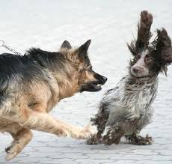
Causes of stress under COVID-19
Unpredictable change – working from home, virtual meetings, constrained movements, and this could be the “new” and challenging environment.
Isolation from family and friends.
Overwhelming responsibilities – work from home, caring for others, possibly bereavement.
Financial worries – loss of work, financial obligations
Uncertainty - When will it all end? When will schools reopen? When can I go back to my place of worship? When can I see my parents / children?
Social stressors - distancing, misconceptions or mis-information, intrusive questions and stigma.
Notes:
Stress is the body’s way of protecting you – you stay focused, energetic, and alert and this can save your life.
BUT too much stress starts causing major damage to your health, mood, productivity, relationships, and your quality of life.
Possible stress under COVID-19

Slide 8
How does stress affect you?
Cognitive: Poor focus and attention, limited concentration, negative self talk.
Physical: Trouble sleeping, sweating, change in appetite, headaches, muscle tension, dizziness, heart palpitations, lack of energy.
Behavioral/emotional: Anxiety, depression, irritability, low self-esteem, indecisiveness, addictive behaviors, acting out, overspending, over/under-eating, panic attacks.
Notes:
https://www.uft.org/sites/default/files/attachments/map-understanding-stress_0.pdf

Slide 9

What, if any, signs of stress are you facing and what solutions are you using to reduce stress?

Slide 10
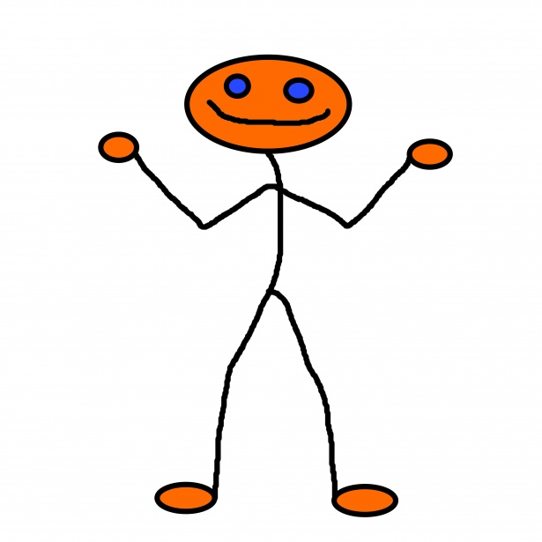
Tips to respond to stress
Acknowledge and understand your reactions; it is common and understandable to have these feelings.
Appreciate that you may experience stress, anxiety, and grief, to the current situation.
Exercise self-compassion – most of us in this situation will experience distress. This is not a sign of weakness.
Understand that anyone whose job is about helping others (e.g. Child Protection Practitioners) might also feel stress.
  Extremely emotionally stressful to witness the difficulties children and families face, and when you have to make difficult care decisions (e.g. removing a child from a home)
Notes:
https://www.apna.org/m/pages.cfm?pageID=6685#excessive%20stress

Slide 11
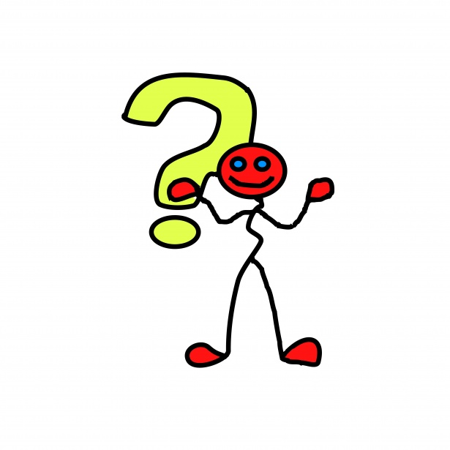
Be aware and monitor your wellbeing (1)
Check in with yourself – every morning and evening, or when you are feeling stressed.
Think about how you are feeling:
  How is your brain working – are you able to think clearly? Are you distracted?
  How are you feeling – are you feeling optimistic or sad, concerned or hopeful?
  How is your behavior – how are you reacting to the situation? Do you feel as if your actions are helpful and constructive or destructive?
  How are you feeling physically?

Slide 12
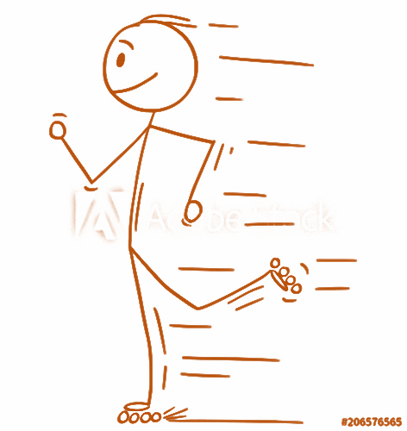
Be aware and monitor your wellbeing (2)
Eat healthily
Reduce caffeine and alcohol consumption
Drink plenty of water
Stay active.
  Try online workout or dance videos or if you can leave the house, take a walk or ride a bike
Practice some form of relaxation
Keep positive thoughts in your head

Slide 13

Be aware and monitor your wellbeing (3)
Take care of your mental health
  Take time to connect with colleagues to share your experiences and validate any feelings of stress or trauma.
  It is OK to take a break from media coverage of COVID-19.
  Schedule time for self-care, such as talking with a friend, reading a book, praying, writing or meditating.
  If you feel this is something you cannot handle on your own, seek help.
Notes:
Stressful situation can be financial – not having income, or no job to go back to; whereas traumatic can be – loved one dying and you cannot attend their funeral,
Give yourself permission to take a take break for your mental health - even if you feel like you cannot take time away.
Seek out a trained mental health professional to help ensure that you are acknowledging your trauma, processing it and have the support you need to manage the lasting impacts over time.

Slide 14
Simple stress reduction technique
1: Set up
Get comfortable
2. Think, feel, body
Ask yourself what you are thinking, how you are feeling emotionally, physically
3. Focus on your breath
Breathe deeply and concentrate on your breathing
4. Coming back
Notice how you feel, the sounds around you
5. Reflecting
Do I feel different at all?
Open your eyes
Notes:
Read the slide and explain that it is sometimes useful just to take some mental ‘time out’. This guidance has been developed for parents and caregivers to ‘walk away’ from a stressful situation with children when we can’t physically get away.
Say that we are all going to do this together now:
Step 1: Set up
•Find a comfortable sitting position, your feet flat on the floor, your hands resting in your lap.
•Close your eyes if you feel comfortable.
Step 2: Think, feel, body
•Ask yourself, “What am I thinking now?”
•Notice your thoughts. Notice if they are negativeor positive.•
Notice how you feel emotionally. Notice if yourfeelings are happy or not.•
Notice how your body feels. Notice anything that hurts or is tense
Step 3: Focus on your breath
•Listen to your breath as it goes in and out.
•You can put a hand on your stomach and feel it rise and fall with each breath.
•You may want to say to yourself “It’s okay. Whatever it is, I am okay.”
•Then just listen to your breath for a while.
Step 4: Coming back
•Notice how your whole body feels.
•Listen to the sounds in the room.
Step 5: Reflecting
•Think ‘do I feel different at all?’.
•When you are ready, open your eyes
End the session by reminding people that they are all working hard in stressful situations. It is always important to care for ourselves. Try this or other techniques to give ourselves the care we need and deserve.
Source: UNICEF tips for parenting during COVID-19 https://www.unicef.org/media/67211/file

Slide 15
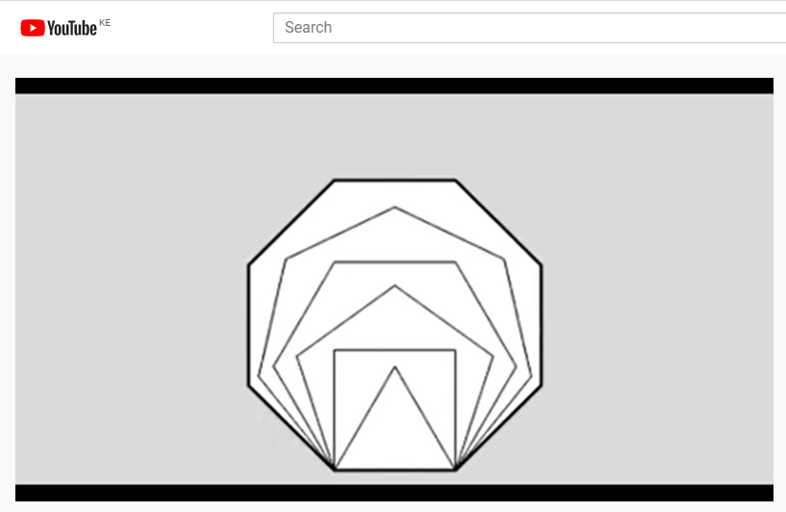
https://www.youtube.com/watch?v=u9Q8D6n-3qw

Slide 16
Building back better – COVID-19 Recovery back better – COVID-19 recover
1: Make your self care regime a life style change
2. Inspire a family member , friend & colleague to adopt a positive lifestyle change
3. Do self care together with your colleague-make it fun and make it a normal part of your day.
4. Initiate a support group with children, adolescents , woman or older persons & empower them with positive lifestyle choices
5. Celebrate the gift of life!!!

Slide 17
And finally
Paying attention to our own needs will help us help ourselves, and others as well.
Connect with your purpose: acknowledge the crucial and noble work you are doing.

Slide 18
Additional Readings.
https://www.uft.org/sites/default/files/attachments/map-understanding-stress_0.pdf - Understanding stress
https://emergency.cdc.gov/coping/index.asp - Taking Care of your Emotional Health
https://www.basw.co.uk/quick-guide-self-care-social-workers-during-covid-19

Slide 19
Breakout time!
Based on what you’ve learned in this webinar, what can you do to promote your own wellbeing during COVID-19?
Nominate one facilitator
Nominate one rapporteur
You have 10 minutes in your breakout room
Provide feedback on the three main points

Slide 21
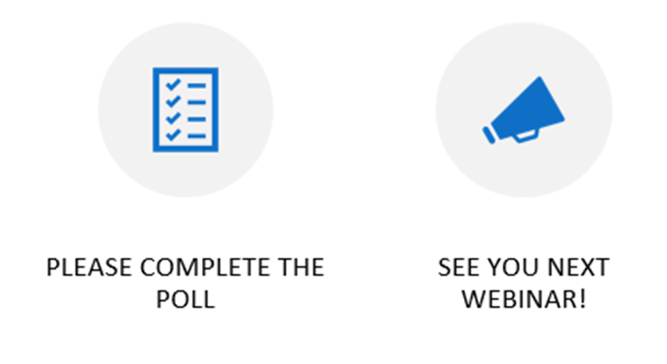
Thank you!

