Slide 1
Webinar: COVID-19, Child Protection and the Health sector
Webinar Training
March 11, 2020

Slide 2
A reminder: Structure of the webinars
Welcome (5 minutes)
Core technical topic (35 minutes)
Breakout rooms (10 minutes)
Reflection (10 minutes)
Post-webinar survey (2 minutes)
Notes:
The emphasis will be on practical information relating to compliance with national guidelines and will seek to provide a strengths-based approach, highlighting successes from Uganda and elsewhere.
Focusing on challenges/uncertainties that participants face, examples of how participants are addressing the problem and creation of an action plan by each county and sub-county Children’s Officer (15 minutes).
This can also be a time to discuss an existing case, or have some self-care activities, if needed and/or requested by the participants.

Slide 4
Outline of Session
Session 1: Welcome and Introduction
Session 2: COVID and the Health Sector
Session 3: How COVID-19 can quickly change the context in which children live
Session 4: How can the COVID-19 related child protection risks increase health risks
Session 5: Health issues that may increase protection risks
Session 6: How can the Health Sector and Social Sectors work together?

Slide 5
Overall objectives of the webinar
Overall aim of the webinar:
To sensitize health workers on child protection issues during COVID-19 that may increase health risks
To identify priority child protection information and actions for the health sector in the context of COVID-19

Slide 6
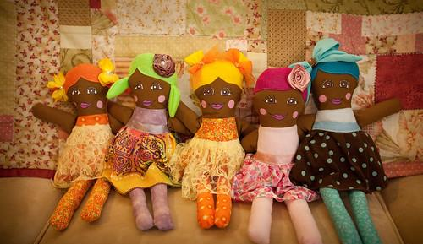
Break out
What are some of the child protection issues that may be exacerbated during COVID-19?
Please respond in chat

Slide 7
2. COVID-19 and the Health sector
Direct impact of COVID-19 on the health sector
People who get seriously ill with coronavirus need health care
COVID-19 is a public health issue – public health measures are needed to prevent spread
Indirect impact of COVID-19 on the health sector
Containment measures restricting access for existing preventive (e.g. immunisation) and routine treatment
Impact on health sector resources - may reduce longer-term resources, may shift focus away from other public health issues

Slide 8
Impact on Health care workers
Essential service workers
High infection rates
Lack of PPE and safe working environment
Long working hours and low compensation
Stress, anxiety, impact on psychosocial wellbeing

Slide 9
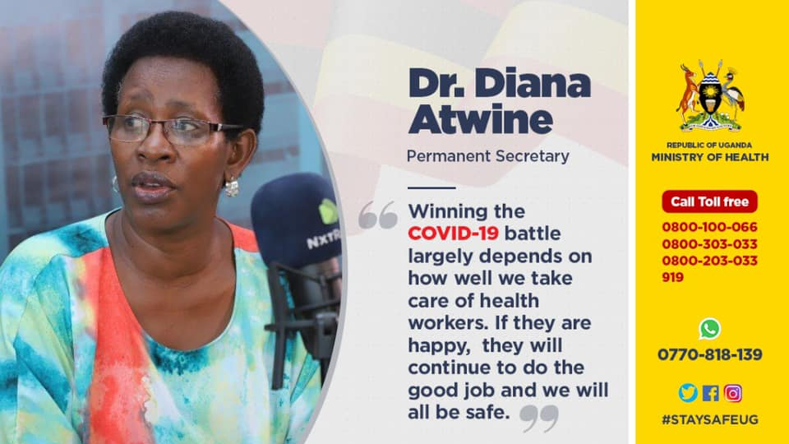

Slide 10
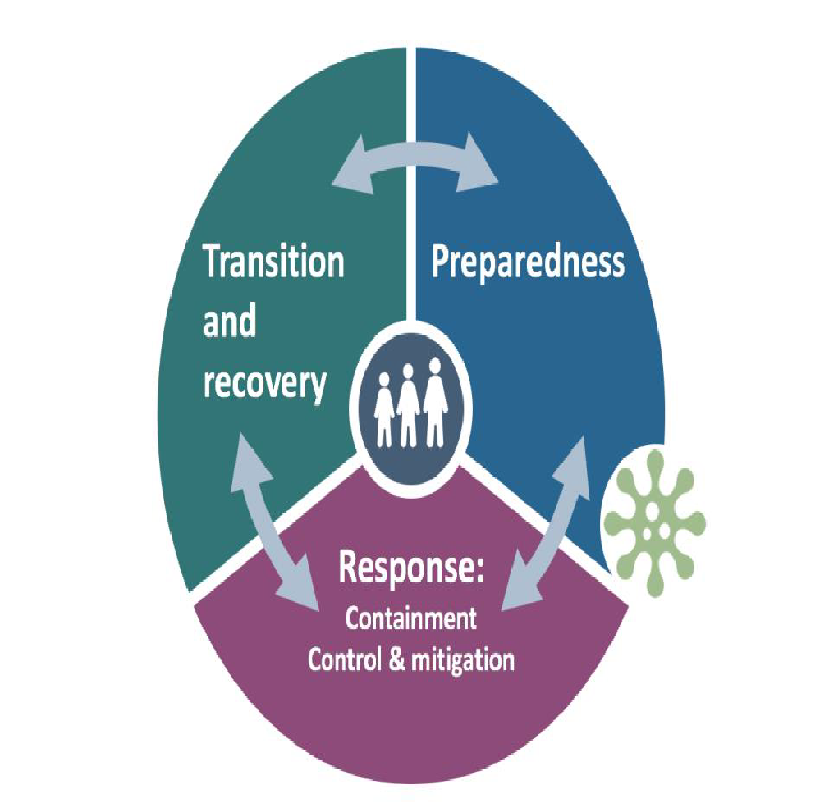
3. How COVID-19 can quickly change the context in which children live
Containment and social distancing measures can result in:
Loss of income or reduced employment increases pressure and stress in the household and can result in:
Closures of school, community or religious functions or venues, reduction in support services and limited access to safe spaces
Prohibitions of family visitation to children in alternative care
Rapid reunification of children from CCIs to families with little preparation or support
Reduced avenues for reporting of VAC cases
Increased domestic violence and violence against children
Psychosocial impact on wellbeing, i such as depression
Increased rates of children engaged in harmful labour, moving to the streets or early marriage
Increased protection risks online

Slide 11
Physical And Emotional maltreatment
Increase in violence (GBV and VAC) and possible online harm
Reduced supervision and neglect of children
Decrease reporting of incidents (e.g., no access to teacher to report)
Containment measures, closure of ECD centres/schools, increased stress in the household due to economic challenges and containment, can result in:
Increased emotional abuse, exacerbated mental health issues (possible self harm)

Slide 12
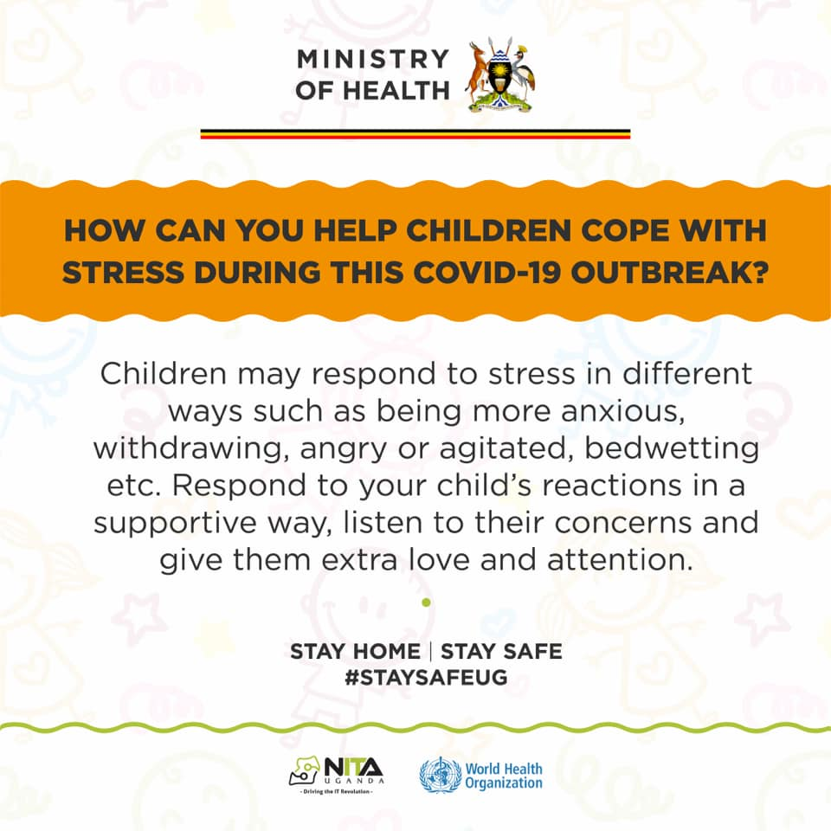

Slide 13
Unaccompanied or separated children
Separation from caregiver due to illness, admission to treatment and quarantine facilities, or death
Removal of child from home due to violence
Child forced to street
Placement in Charitable Children’s Institution or quarantine

Slide 14
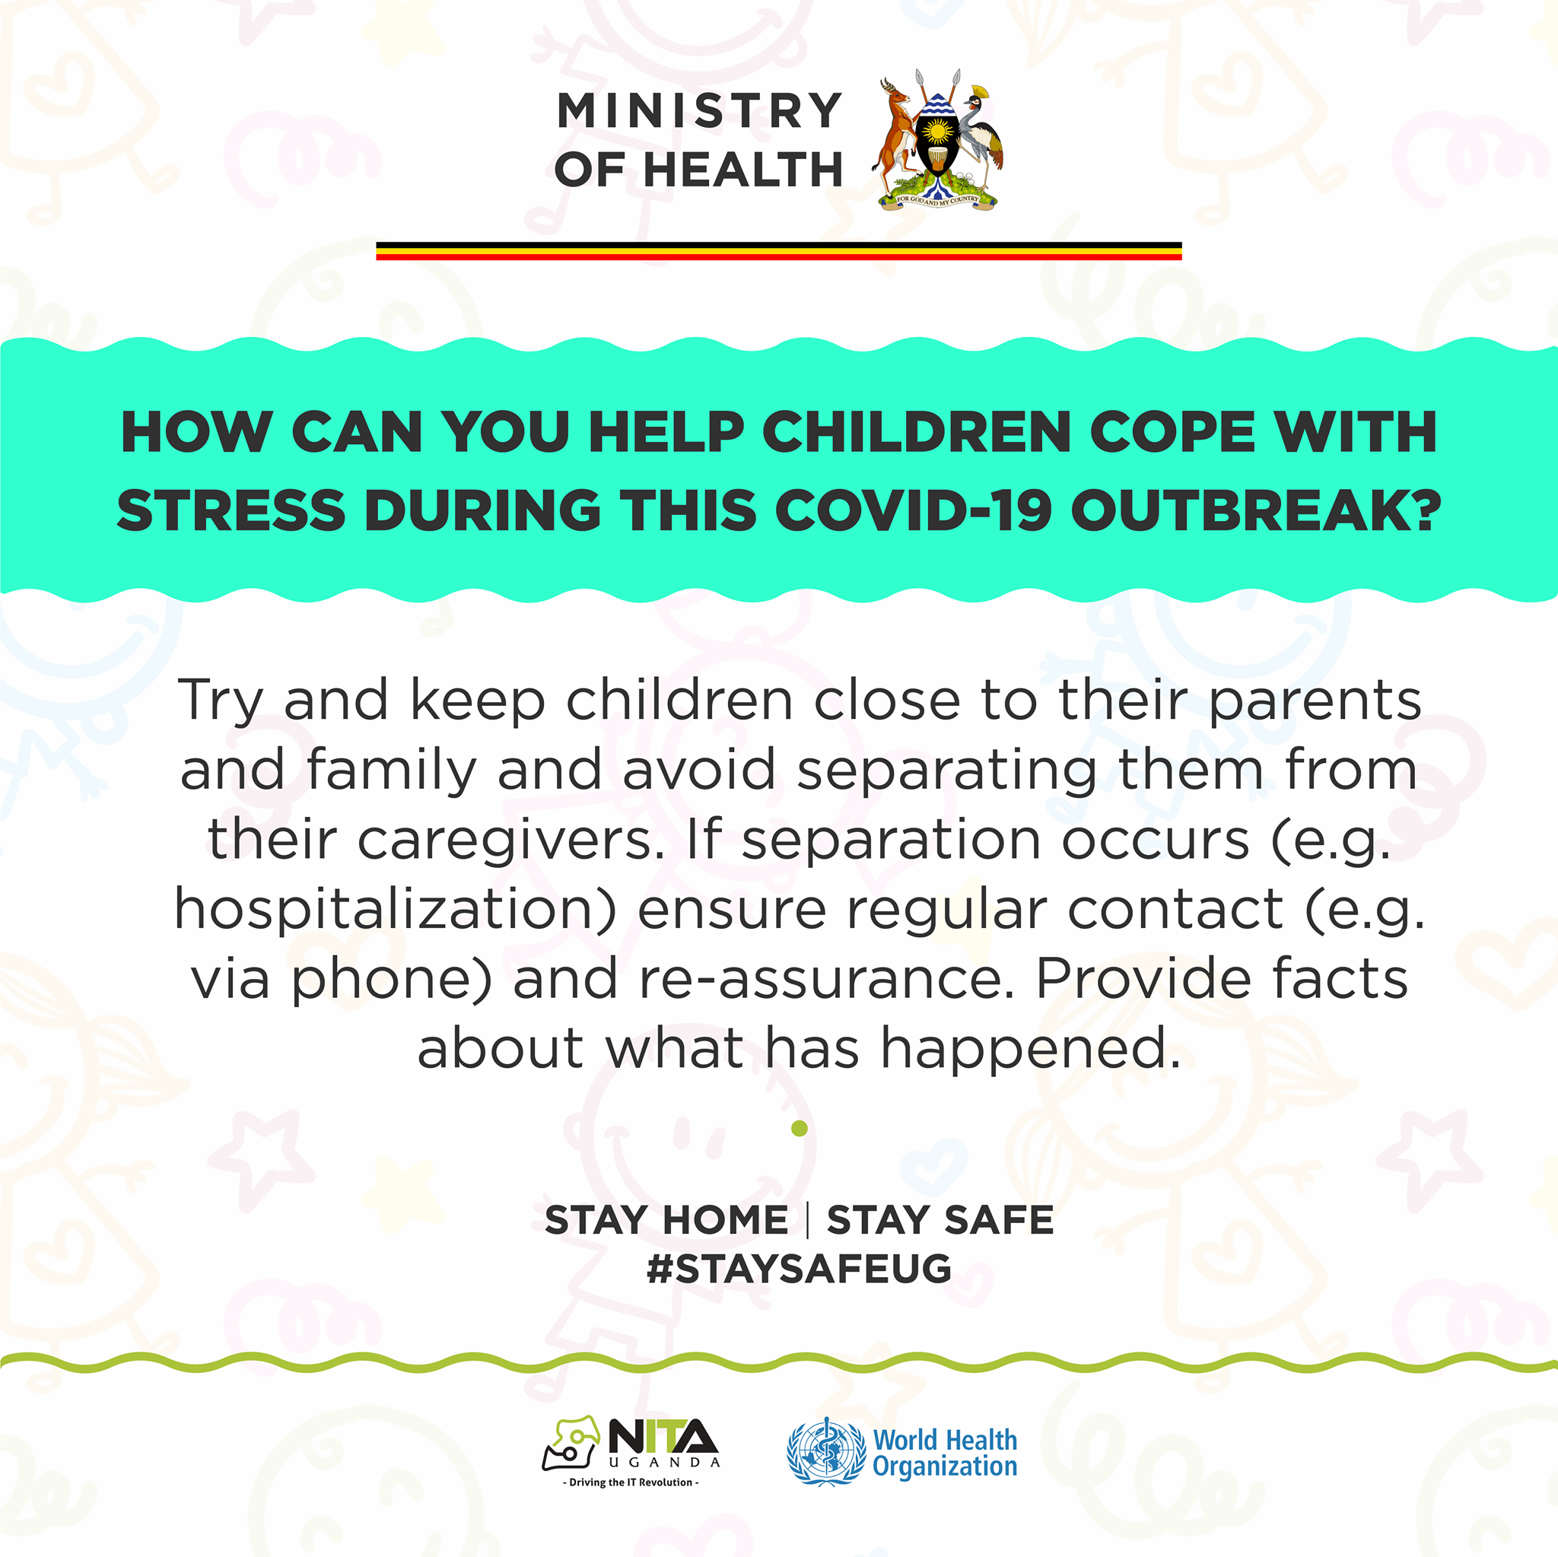

Slide 15
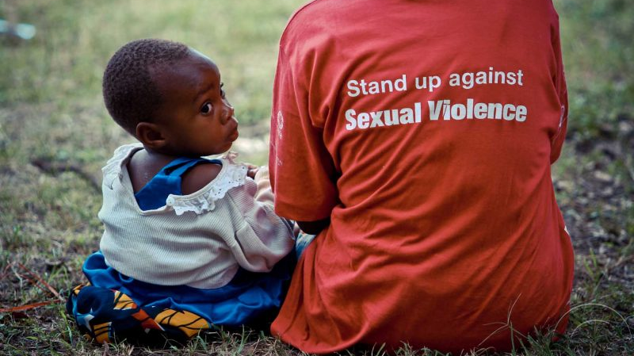
COVID-19 and SGBV, VAC
Household economic stress, increased responsibility of children in the household (cooking, cleaning, fishing), closure of schools, and obstacles to reporting violence, can result in:
Increased risk of sexual exploitation, including online risks
Increased child marriage-resulting from transactional sex, teenage pregnancies, and as coping mechanisms, etc.
Increase in FGM
Reduction in reporting and responding due to containment measures/barriers

Slide 16
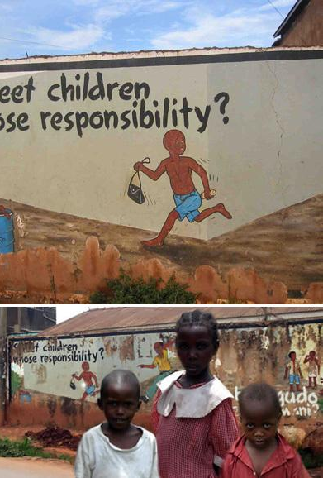
Social exclusion
Containment measures, closure of services (shelters, etc.) can result in:
Stigma and discrimination towards those most at risk of coronavirus or those who have had it or are a contact.
Children on the streets or on the move “fall through the cracks” of prevention and response efforts (invisible)
Children in residential care (statutory and private) rapidly reunified to unprepared families and communities
Children with disabilities excluded from support and unable to report if a victim of violence
Notes:
Photo credit: UNICEF Kenya

Slide 17
Chat box
Are you seeing child protection concerns in the children and families you support?
This Photo by Unknown Author is licensed under CC BY-SA

Slide 18
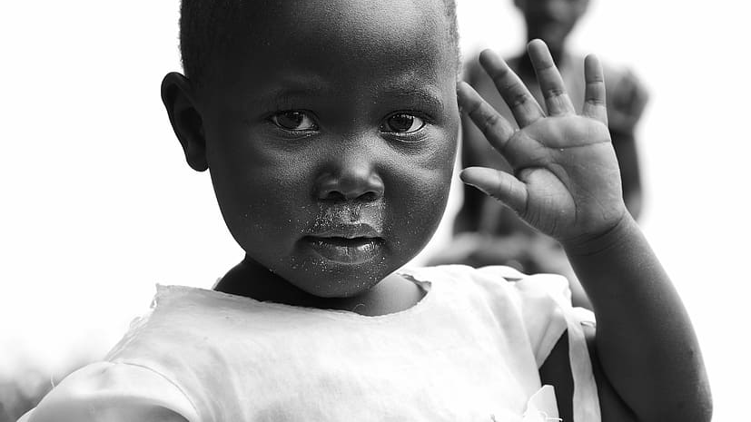
4. How can the COVID-19 related child protection risks increase health risks?

Slide 19
CP risks (during pandemic) that may increase health risks
Physical and emotional maltreatment
SGBV
Mental health and psychosocial distress
Social exclusion
risks of injuries
Risks of sexually transmitted illness e.g. HIV
Worsening of pre-existing mental health conditions
Limited support for vulnerable children
mental health problems
Mental health problems e.g. depression, anxiety, PTSD
Self-inflicted injuries & suicidal attempts
Closure of social services leading to malnutrition, diarrheal diseases
Alcohol and substance abuse
Unintended pregnancies and pregnancy complications
Psychosomatic disorders
Economic impact on family, impacting nutrition and health
Notes:
Physical health:
Reduced supervision and neglect of children
Poisoning and other injuries in the home
Increase in child abuse and sexual and gender-based violence where families are spending more time together at home
Mental health:
Stress and worry about COVID-19 risks, containment, economic instability and uncertain future
Social isolation can evoke feelings of loneliness and depression in some cases
Worsening of pre-existing conditions
Reduced access to ongoing care and services

Slide 20
Adolescent health issues in context of COVID-19
Adolescent pregnancies
Concerns about increased risk of pregnancy during COVID-19 containment measures.
Adolescent girls at high risk of sexual violence at all times; increase during COVID-19.
Adolescent mothers may face economic stress and often lack social support – harder during public containment measures.
Notes:
Adolescent pregnancy data: 23.3% gave birth before age 18; 4.1% before age 15 overall – of girls with only primary education, 38.3% before age 18 and 6.2% before age 15.
2014 DHS, sourced from UNFPA https://www.unfpa.org/data/adolescent-youth/KE INPUT UGANDA STATS
More than One third of adolescent girls 15-19 years in a union do NOT have their contraceptive needs met.

Slide 21
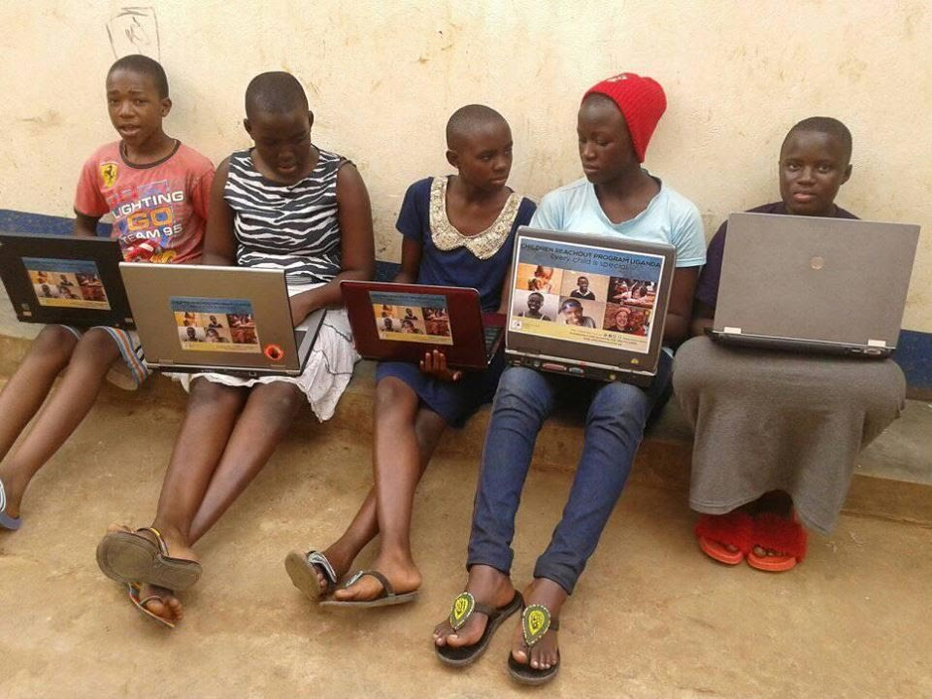
Steps to support adolescent girls
Link COVID-19 prevention messages with SRH information (jointly with health sector).
Make sure information about online safety reaches adolescent girls home from school / out of school.
Discuss ways of keeping adolescent girls busy without overloading with domestic responsibilities.
Encourage adolescent clients to continue to access SRH and HIV services.
Identify ways that adolescent girls and boys can be community volunteers.
Notes:
Emerging information about online safety : girls hooking up with potential abusers, offers of marriage, etc. Plus ongoig important of online safety

Slide 22
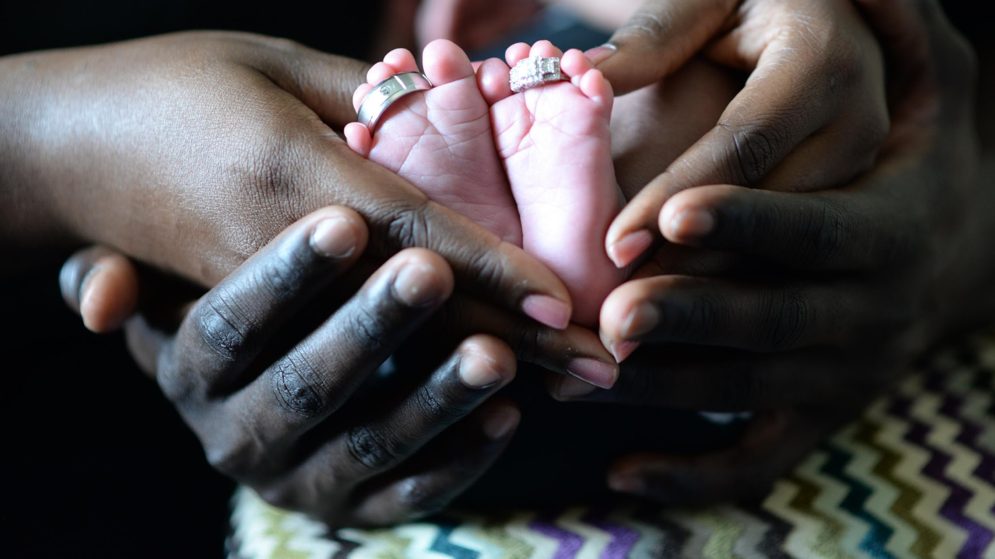
5. Health issues that may increase protection risks

Slide 23
Health issues that may increase protection risks
Reduced access to ongoing medical care may increase stress, ill-health so possible neglect and violence
For example, inconsistent access to HIV treatment
Lack of access to antenatal support (formal and traditional) or early childhood care
Increase in stress on caregiver and family, especially new mothers
Family separation in case of sickness, isolation or quarantine
Need for alternative care, but prospective caregivers may fear infection
Loss of income due to sickness, isolation or quarantine
Family less able to meet basic needs incl. food

Slide 24
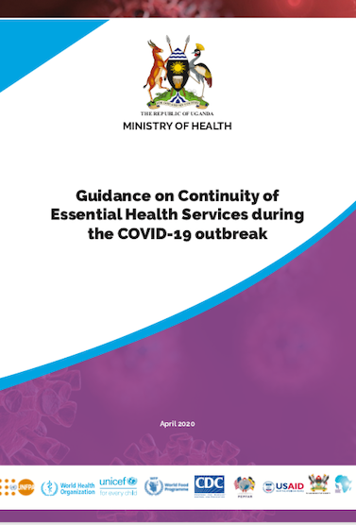
MoH Guidelines April 2019
Annex 12. Guidelines On Providing Mental Health And Psychosocial During
COVID-19 Pandemic Response
Annex 13. Provision of Sexual Reproductive Health, HIV and gender based Violence services in the context of COVID-19
Annex 14. Interim Guidelines For continuity of care and wellbeing of adolescent and young people during COVID-19 Outbreak

Slide 25
6. How can the Health Sector and Social Sectors work together?

Slide 26
What can the social services/ child protection sector do to support the health sector
COVID-19 risks
Identify children or families who may be especially at risk of more severe COVID-19 illness (immuno-compromised and/or poor nutrition)
Urgent health risks
Identify and refer children and vulnerable adults with immediate and severe health issues e.g. violence-related, mental health
Chronic health needs
Identify and highlight other health challenges, e.g. challenges in access to chronic health medicine such as HIV treatment

Slide 27
What can the health sector do to support child protection
Be aware
Be aware of child protection risks when seeing clients, and refer
Ask
Ask basic child protection questions during COVID-19 health assessments
Prevent CP risks
Uganda Child Helpline 116
Report and refer child protection concerns to relevant structures
Prevent family separation
Talk to caregivers in case of family illness
Contract child protection actors to support
Share public health messages
Share local information on public health messages with child protection actors for dissemination
Notes:
Ask key CP questions during health assessments:
: Is there a need to consider safe, appropriate, family-based care if there is a risk of separation? Is there a need to work with a social worker if violence or maltreatment is suspected?
This is good but we shouldn't be misleading health staff to think they should ask direct questions such as whether the child has experienced violence. Depending on who is targeted through this session this can be adjusted.

Slide 28
Planning together
Identify via local coordination focal points where health has broad reach vs where protection has broad reach – how can each “piggyback” on the other?
Work with health actors to develop strategies to include marginalized and hard to-reach children
Check SOPs locally to ensure smooth referral between health and protection sector - Can health service providers add basic protection questions to their screening?
- Are health workers collecting key information about children under the care of adults that are admitted and sharing this information with relevant social welfare structures? - Are health service providers clear on referral pathways to social services and police?
Basic (virtual) child protection training for the health sector

Slide 29
Acting together
Ensure children and families can access free health care
Shared factsheets – staying healthy and safe, with local numbers, shared dissemination
Prepare child-friendly mental health and psychosocial support care messages

Slide 30
“Building back better” as containment measures loosen
Health & nutrition
Contact children and families in your case load and identify priority health cases e.g. people living with HIV or other chronic conditions, families living with longer-term coronavirus effects, elderly caregivers
Family strengthening
Work with health sector to ensure ongoing prevention e.g. nutrition support
Referrals & coordination
Continue effective referrals
Maintain or establish ongoing case conferencing and case management
Utilise local coordination mechanisms which may be able to physically meet again
Protective health services
Continue to sensitize health sector on child protection risks
Shared training and awareness raising, e.g. on violence prevention and response
Adolescent focus
COVID-19 has highlighted the combined protection and health challenges that adolescents and their caregivers face
Need for greater focus on combined adolescent health and protection interventions

Slide 31
Additional reading
MoH Uganda (April 2019): Guidance on Continuity of Essential Health Services during the COVID-19 outbreak
UNICEF Kenya: Tips for adolescents
https://www.unicef.org/kenya/stories/how-teenagers-can-protect-their-mental-health-during-coronavirus-covid-19
UNFPA, COVID-19: Working with and for young people
https://www.unfpa.org/sites/default/files/resource-pdf/COMPACTCOVID19-05.pdf
Alliance for Child Protection in Humanitarian Action. Protection of Children During the Coronavirus Pandemic, v2.
https://alliancecpha.org/en/system/tdf/library/attachments/the_alliance_covid_19_tn_version_2_05.27.20_final_2.pdf?file=1&type=node&id=37184

Slide 32
Breakout time!
Please write down this question:
What actions can be taken by health service provider in your community to strengthen their response to child protection risks?
How should the health sector and child protection sector work together?

Slide 33
Thank you!

